Slide 1
Evidence for Continental Drift
PowerPoint 12.1

Slide 2
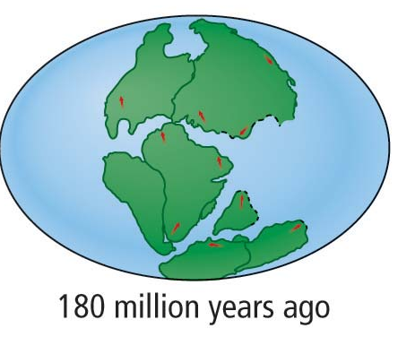
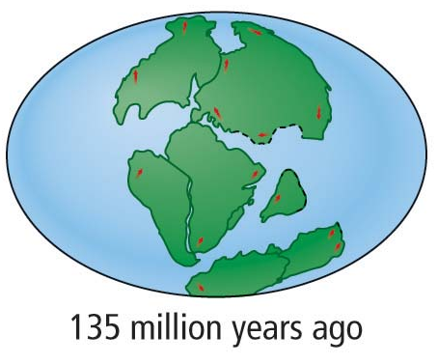
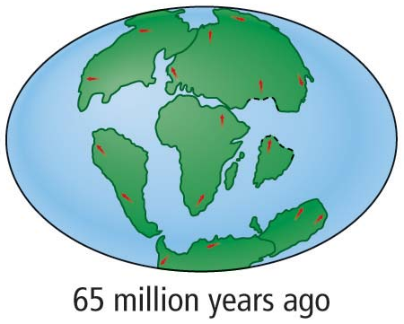
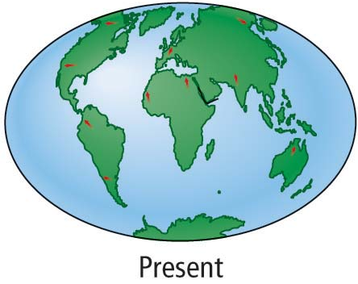
What is the Continental Drift Theory?
Continents have not always been in their present locations but have “drifted” there over millions of years.

Slide 3
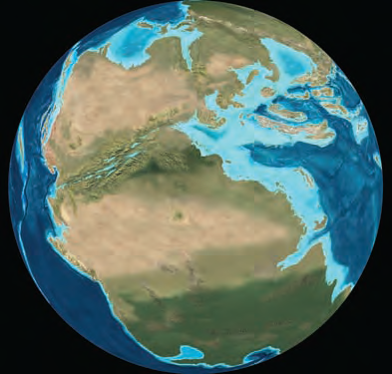
Supporting Evidence for Continental Drift
1. Continents fit together like puzzle pieces.
Pangea
2. Similar geological structures and rocks on either side of the Atlantic Ocean.

Slide 4
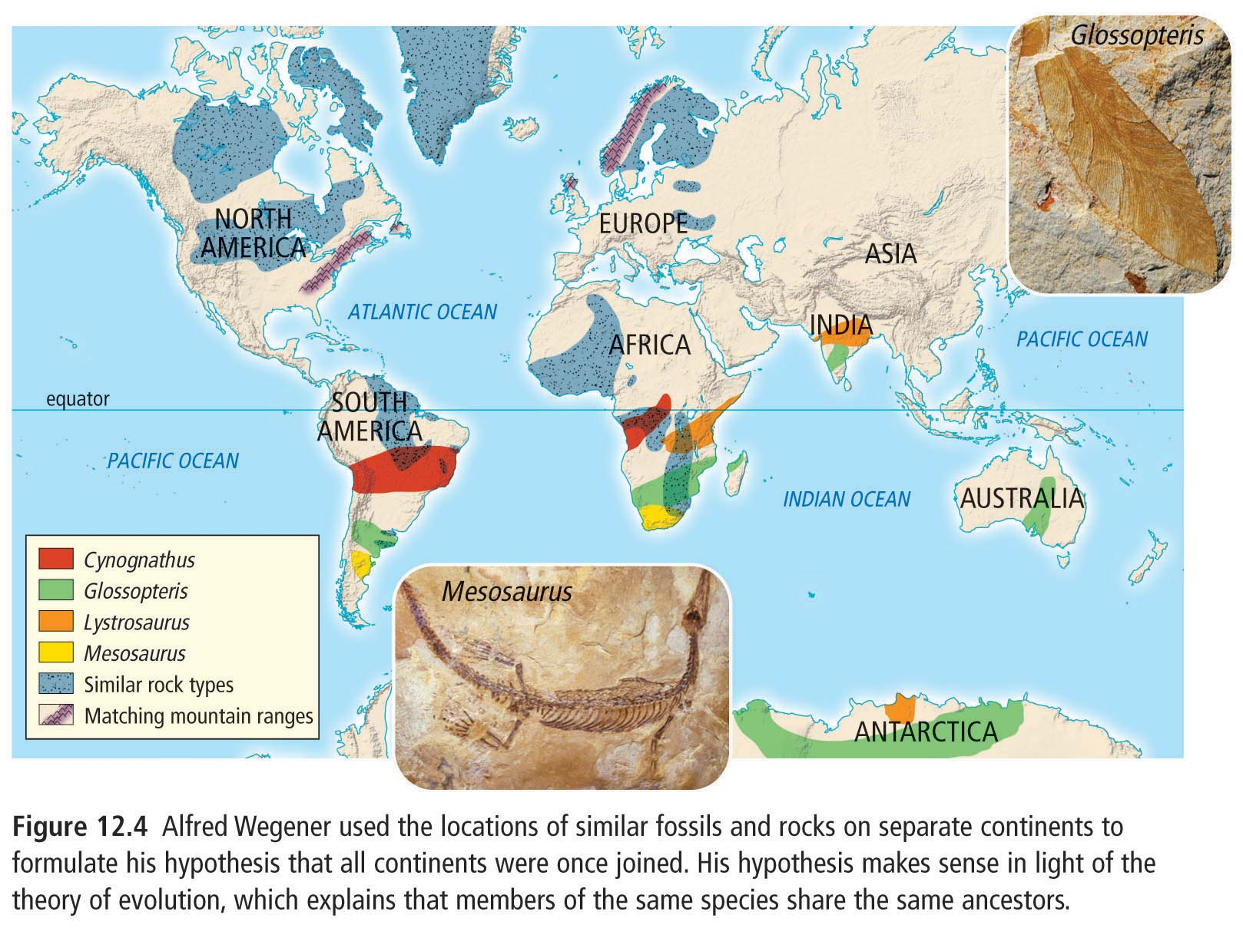
Supporting Evidence for Continental Drift
3. Similar fossils can be found on different continents

Slide 5
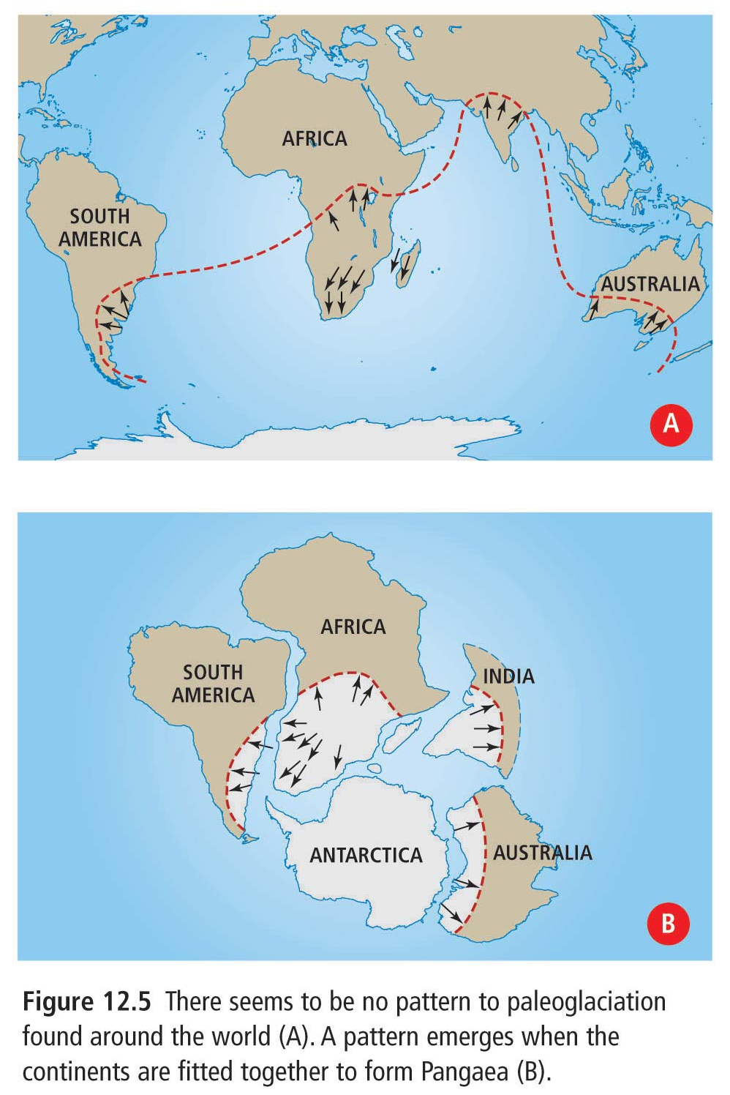
Supporting Evidence for Continental Drift
4. Climatic evidence
Paleoglaciation indicates that tropical regions once contained glaciers.
Coal deposits in Antarctica indicate that this continent was once inhabited by living organisms.

Slide 6
How Do Continents “Drift”?
The Earth’s crust is divided in large slabs of rock called tectonic plates.
These plates spread apart and collide with another over millions of years.
Notice the
Mid-Atlantic Ridge.

Slide 7
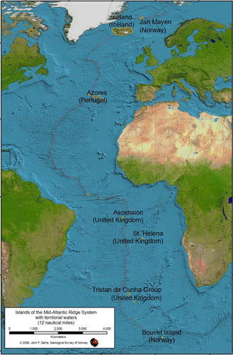
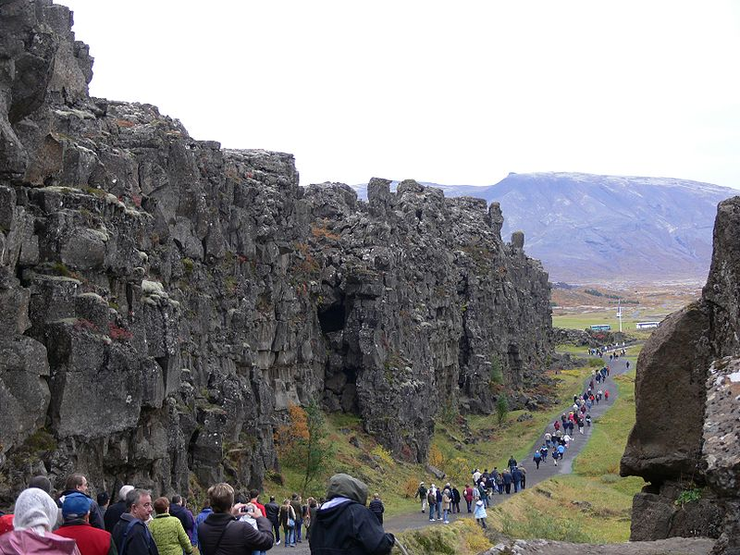
Mid-Atlantic Ridge
Mid-Atlantic Ridge on land in Iceland

Slide 8
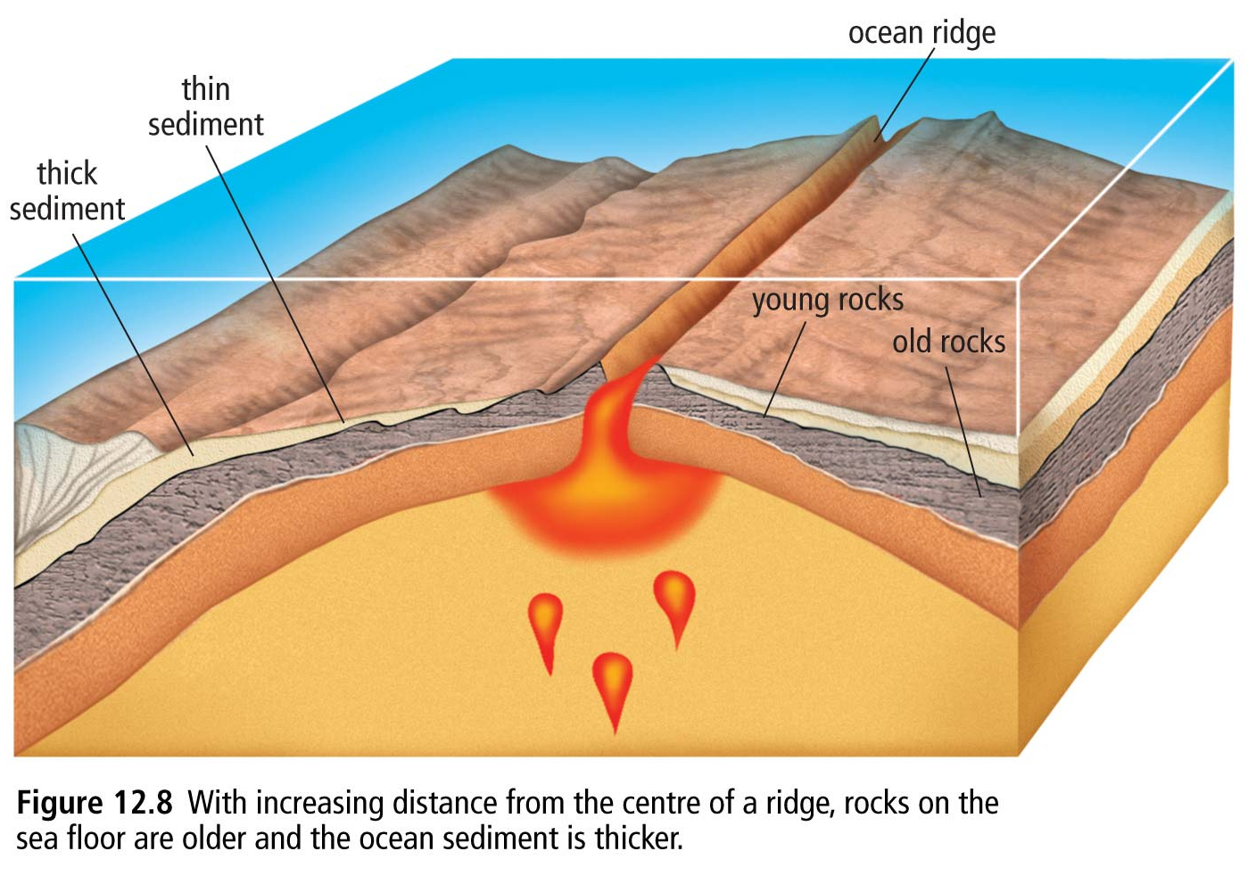
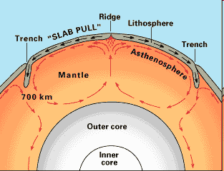
Sea-Floor Spreading
Convection currents are produced as magma which is less dense than its surroundings, wells up within the mantle.

Slide 9
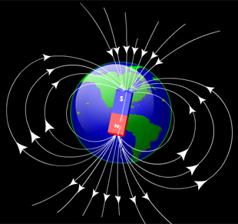
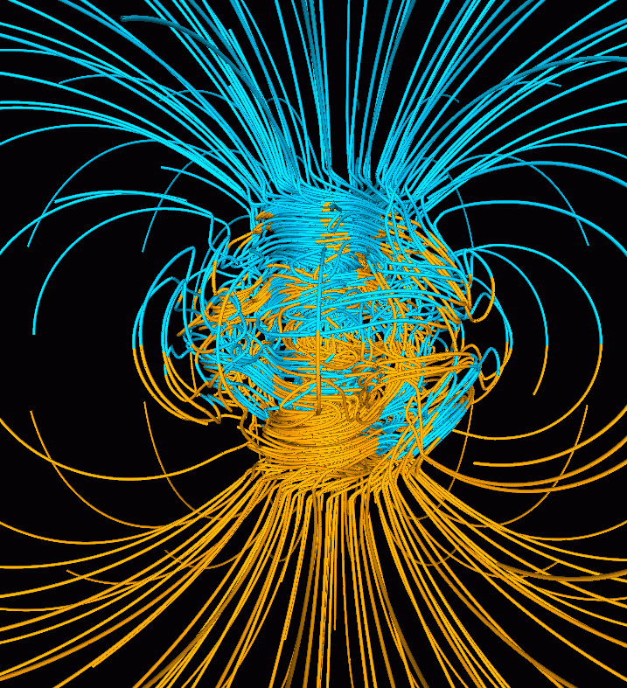
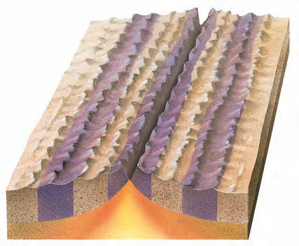
Paleomagnetism
Young rock
Normal Polarity
The reversals of Earth’s magnetic poles is captured in the iron-rich sea floor on either side of the Mid-Atlantic Ridge.
Discovered utilizing a magnetometer.
Reverse Polarity
Older rock
Magnetic Striping

Slide 10
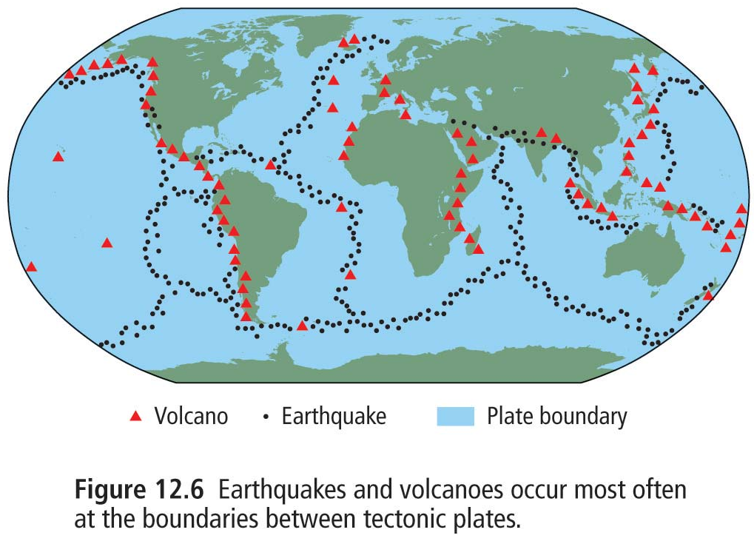
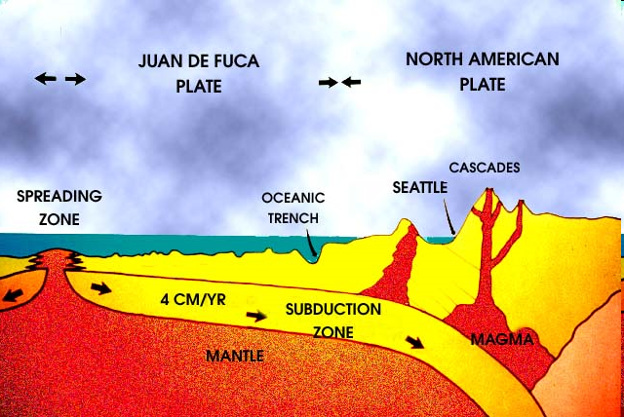
Evidence and Consequences of Plate Tectonic Theory
Volcanoes and earthquakes often occur at plate boundaries due to friction and collisions between plates.
The “Ring of Fire” on Pacific coastlines is so named due to this phenomenon.

Slide 11
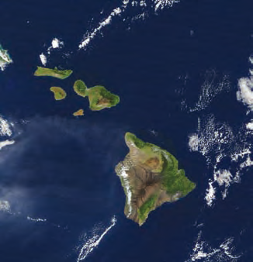
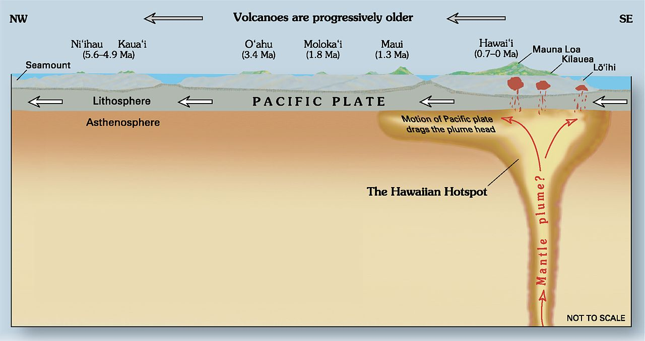
Volcanoes and Hot Spots
Volcanoes can also occur over hot spots as is the case of the Hawaiian Islands.
Scientists think that the Hawaiian Islands formed as the Pacific Plate moved toward the north-west over a hot spot.

Slide 12
Summary
The Earth’s crust is divided into tectonic plates that move around on top of a molten layer.
Plate Tectonic Theory (formerly known as Continental Drift Theory) is supported by several factors
Physical shape of continents
Geological and rock similarities
Fossil similarities
Climatic similarities
The Mid-Atlantic Ridge is a divergent oceanic-oceanic plate boundary at which new rock surfaces, solidifies, and pushes older rock to either side.
Magnetic striping supports this principle.

