Slide 1
Atomic Theory
PowerPoint 4.1

Slide 2
What do you remember from Grade 9?
proton
physical change
atomic mass
chemical change
ionic bonding
Bohr diagram
neutron
covalent bonding
ion
valence electrons
nucleus
electron
atomic number

Slide 3
Links between Kinetic Molecular Theory and Atomic Theory
Kinetic molecular theory
All matter is made up of very small particles.
There is empty space between particles.
The particles are constantly moving. These particles are colliding with each other and with the walls of the container.
Energy makes particles move. The more energy the particles have, the faster they move and the farther apart they can get.
atoms and compounds
O
H
H

Slide 4
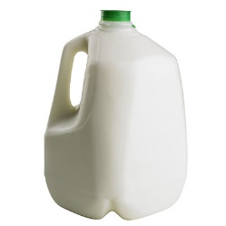
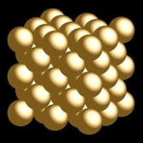
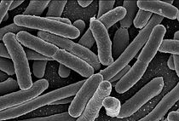
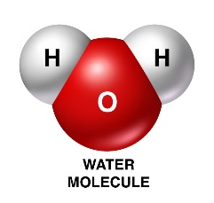
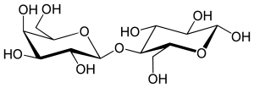
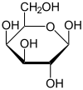
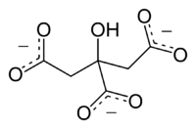
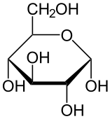
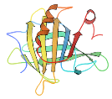
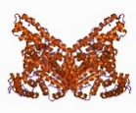
Pure Substances
A substance composed of only one type of particle.
Classified as either an element or a compound.
Au
element
Au
And many others!
Mg²⁺
compound
Ca²⁺
H₂O
lipids
phosphoproteins
proteins
Particules du lait,
http://www.ilri.org/InfoServ/Webpub/fulldocs/ilca_manual4/Milkchemistry.htm

Slide 5
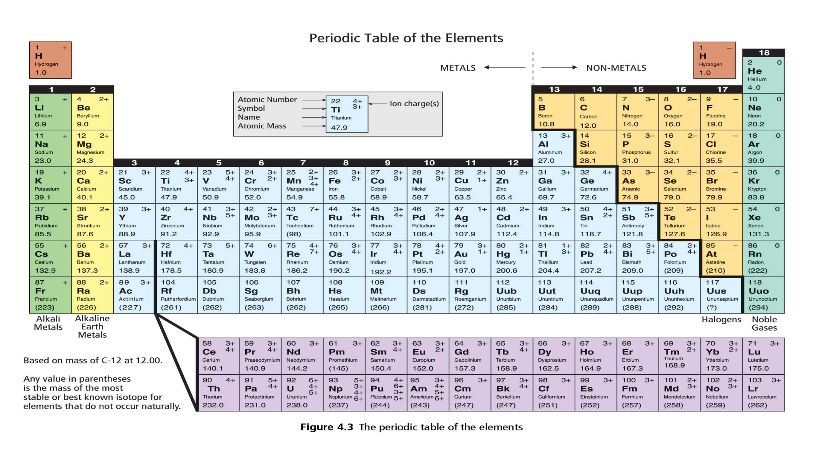
The Periodic Table of Elements
Right side, not shiny, poor conductors, brittle, not ductile
Non-metals
Ionic charge
Atomic
number
17
-
Cl
Element
symbol
Element
name
chlorine
35.5
Atomic mass
Metalloids
Share some properties with metals and some with nonmetals
The rest are metals
Left side, shiny, conductive, malleable, ductile

Slide 6
Rows in the Periodic Table are called periods.
Groups and Periods
3
2
1
P
Columns in the Periodic Table are called groups or families.
1
2
3
4
5
6
7
6
7
The number of the period in which an element is located is equal to the number of energy shells in its neutral form.
Elements of the same group or the same period have similar chemical and physical properties.
1 2 3 4 5 6 7 8 9 10 11 12 13 14 15 16 17 18

Slide 7
Important Groups and Sections
Noble gases
Alkali metals
Alkaline-Earth Metals
Halogens
Transition metals

Slide 8
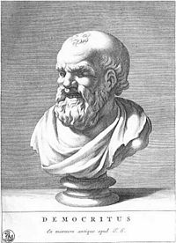
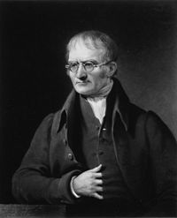
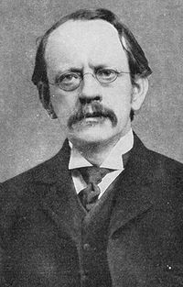
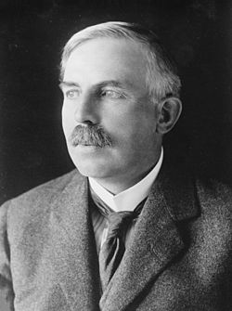
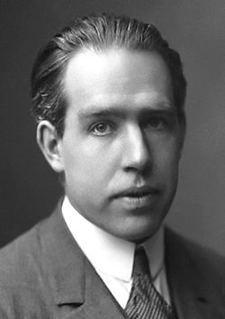
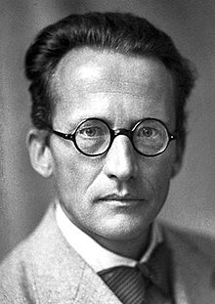
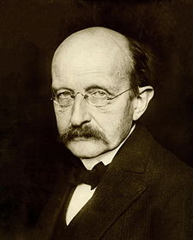
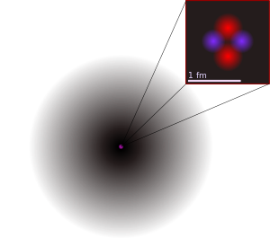
History and development of the Atomic Theory
Law
1897
≈433 B.C.
1803
1909
1913
You’re welcome.
Democritus
John Dalton
J. J. Thompson
Ernest Rutherford
Niels Bohr
2
Atomos

Slide 9
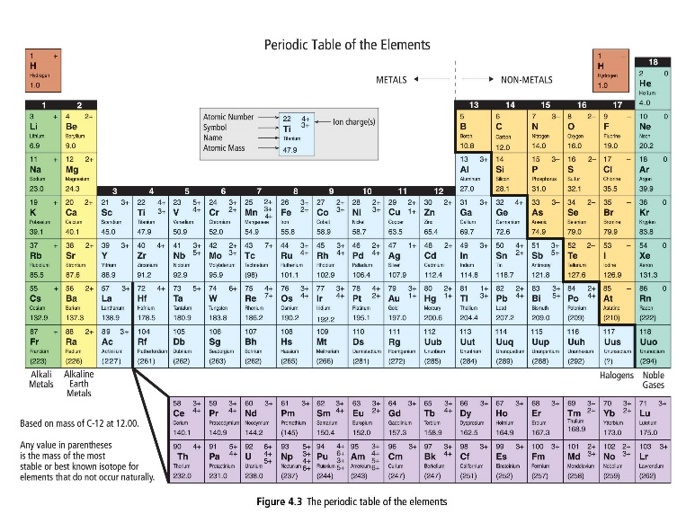
The atom
The smallest particle of any elements that still retains the properties of that element.
Nucleus
Energy levels
or shells
or orbitals
Particules subatomiques
Electron
Proton
Bohr diagram for an atom of oxygen
Neutron

Slide 10
Subatomic particles
Location
Mass
Charge
Subatomic particle
Proton
Electron
Neutron
the nucleus
1 a.m.u.
1+
219 pounds!
Iron Mike is in da house!
WTF!?
1.67262178 x 10⁻²⁷ kg?!
I think the scale’s broken.
energy levels
around the nucleus
$\frac{1}{1837}$ a.m.u. ≈ 0 a.m.u.
Oh! That’s about 1 a.m.u.
That’s easier.
1-
the nucleus
1 a.m.u.
0
The nucleus
Contains the atom’s protons and neutrons
Positively charged
99.99% of the mass of the atom
Extremely small and dense
Larger nuclei are more unstable due to the
repulsion of protons within the nucleus.
Mike Tyson
Proton

Slide 11
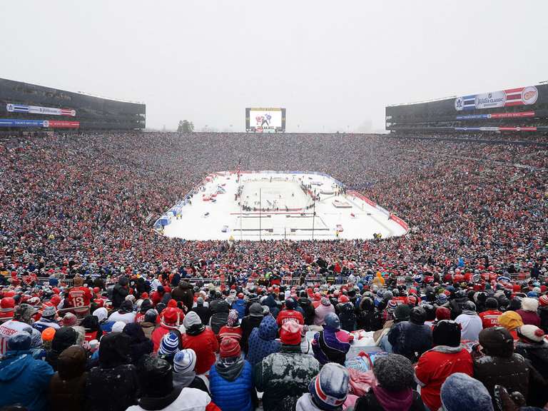
Are you kidding me?
Nothing!
?

Slide 12
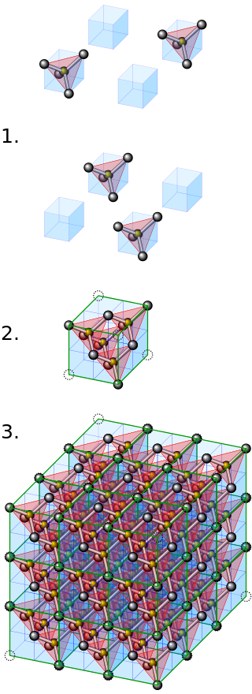
But…Why?

Slide 13
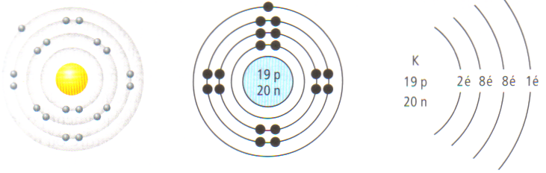
Bohr diagram of the atom
There are a few variations of Bohr diagrams.
They each indicate the number of electrons on each shell.
Various Bohr diagrams for the potassium atom, K
K
K

Slide 14
Drawing a Bohr Diagram of an atom
Li
3p
4n
3
+
Li
Lithium
6.9
Bohr diagram for lithium atom
NEUTRAL atom→
3p and 3é
#p = #é
(#p)
≈ 7
=
(3)
+
(#n)
4

Slide 15
Try drawing one yourself
N
7p
7n
7
3-
N
Bohr diagram of a nitrogen atom
nitrogen
14.007
14 – 7 = 7
NEUTRAL atom→
7p and 7e
#p = #e
(7)
(#n)
≈ 14
=
(#p)
+
7

Slide 16
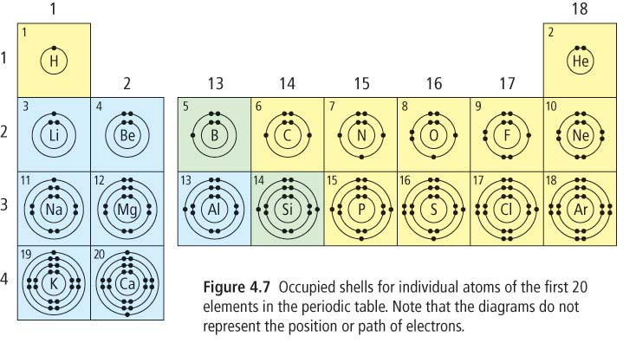
Bohr diagrams
Bohr diagrams of the first 18 elements

Slide 17
Electronic configuration of elements of the same group
Alkali metals
H
Li
Na
K
Rb
Fr
Cs

Slide 18
Electronic configuration of elements of the same group
Alkaline-Earth metals
Be
Mg
Ca
St
Ra
Ba

Slide 19
More Atomic Terminology
Valence shell
Outermost shell containing electrons
Ar
Valence electrons
Electrons in the valence shell
Electrons that interact during chemical reactions and that participate in chemical bonds.

Slide 20
Stable Octet
Noble gases are particularly non-reactive, or stable, because their atoms have valence shells that are already full in their neutral state.
Noble gases
He
Ne
Ar
Kr
Cs
Octet rule
Atoms « like » having a full valence shell, often containing 8 electrons.
Atoms of non-noble gas elements must add or remove electrons in order to have a full valence shell, thereby becoming ions.

Slide 21
Ions
Atoms that gain or lose one or more electrons are called ions.
The number of protons in the nucleus is not equal to the number of electrons surrounding the nucleus
Ions carry a positive charge (cations) or a negative charge (anions).
Fluorine is often found in its ionic state, the fluoride ion.
Fluorine adds an electron in order to fill its valence shell thereby becoming an anion.
-
9
-
29
2+
1+
F
9p
The charge of the ion commonly formed for each element is indicated in the top right-hand corner of the element’s box.
F
Cu
Elements with more that one possible ionic charge are called multivalent elements.
Fluorine
Copper
19.0
63.5

Slide 22
Compounds
A compound is formed when two or more atoms connect together via an exchange or sharing of electrons.
Two main types of compounds,
1. Ionic compounds
2. Covalent compounds or molecules

Slide 23
Ionic Compound Formation
In order to fill their valence shell, atoms will exchange one or more electrons.
Sodium
Chlorine
Sodium ion
Chloride
Notice that,
metals will typically lose electrons, becoming cations,
non-metals typically add electrons to be come anions,
ionic compounds typically contain a metal and a non-metal.
Sodium chloride
+
-
Na
Cl

Slide 24
Ionic Compounds
Formed by the attraction between oppositely charged ions.
Opposite charges attract and like charges repel one another
Bohr diagram of the ionic compound NaCl
+
-
Chemical formula, NaCl
Chemical name, sodium chloride
Chemical equation, Na⁺ + Cl⁻ → NaCl
Na
Cl
Sodium ion
chloride

Slide 25
Try drawing the ionic compound with the following chemical formula
Li₂O
+
+
2-
Li
Li
O
Try writing the chemical equation for the formation of this compound,
2Li⁺ + O²⁻ → Li₂O
Try writing the chemical name for this compound,
Lithium oxide

Slide 26
Covalent compounds or Molecules
Covalent compounds, or molecules, involve a sharing of electrons.
Electron pairs not involved in the bond electrons are sometimes called a lone pair.
Shared electrons are sometimes called a bonding pair.
O
H
H
Atoms in a water molecule are covalently bonded
Chemical equation, 2H + O → H₂O

Slide 27
Try drawing the molecule with the following chemical formula,
CH₄
H
Ensure that you indicate that electrons that are shared between atoms are placed on the valence shells of the atoms involved.
they should overlap
H
C
H
Notice that covalent compounds often contain only non-metals.
H
Chemical equation for the formation of this compound is
C + 4H → CH₄

Slide 28
Lewis Diagrams
A Lewis diagram (or a Lewis structure or an electron dot diagram) is a diagram that illusrates chemical bonding by showing only an atom’s valence electrons (lone pairs and bonding pairs) and the chemical symbol.
Bohr diagram of a nitrogen atom
Lewis diagram of a nitrogen atom
Dots represent electrons and are placed around the chemical symbol at the points of a compass.
Electron dots are placed singly until the fifth electron is reached, then they are paired
Helium is a bit of an exception
N
N
He

Slide 29
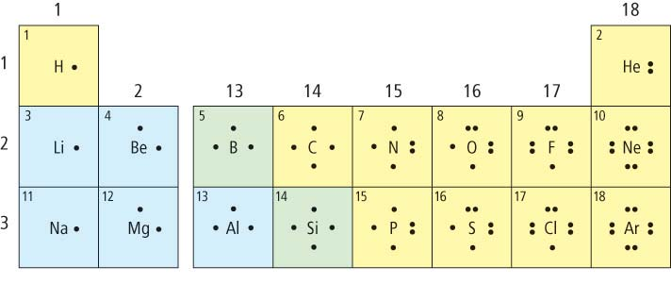
Lewis diagrams
Lewis diagrams of the first 18 elements

Slide 30
Lewis Diagrams for Atoms, Ions, and Compounds
Atoms
Ions
Covalent compounds
(molecules)
+
Sodium
Na
Sodium ion
Na
Water, H₂O
Oxygen
Oxide ion
O
2-
H
O
O
H
O
or
Ionic compounds
H
H
Sodium oxide, Na₂O
+
+
2-
Each line represents two shared electrons
Na
Na
O

Slide 31
Lewis Diagrams of Diatomic Molecules
Some elements exist naturally as diatomic molecules because they are more stable together than as individuals.
A pair of atoms joined by a covalent bond
Hydrogen
H₂
Fluorine
F₂
Chlorine
Cl₂
Bromine
Br₂
Iodine
I₂
Oxygen
O₂
Nitrogen
N₂
H
H
F
F
Cl
Cl
Br
Br
I
I
O
O
N
N
Bonding pair
Lone pair

Slide 32
Summary
Subatomic Particle Location Mass Charge
Proton nucleus 1 amu 1+
Electron shells ≈ 0 amu 1-
Neutron nucleus 1 amu 0
Bohr diagram
Lewis diagram
Valence electrons
Li
Li
Ionic compound
+
+
2-
Ionic charge
Na
Na
O
17
-
Atomic number
Cl
Covalent compound
Element symbol
Lone pair
H
O
Element name
chlorine
Bonding pair
Atomic mass
35.5
H

