Slide 1
Chemical Names and Formulas of Compounds
PowerPoint 4.2

Slide 2
Reminder of the Information in PowerPoint 4.1
Ionic compounds and molecules can be represented in drawings utilizing Bohr models or Lewis diagrams.
These compounds can also be represented in the following ways,
  Chemical formulae
  Chemical names
  Chemical equations
Bohr diagram of the ionic compound sodium chloride
+
-
Chemical formula NaCl
Chemical name, sodium chloride
Chemical equation, Na⁺ + Cl⁻ → NaCl
Na
Cl

Slide 3
Things to Know about Ionic Compounds
cation
anion
Each ionic compound has a positive ion and a negative ion.
+
-
Li
F
Metal
Non-metal
The name of the negative non-metal ion always ends in –ide.
Chloride Cl⁻
Bromide Br⁻
Iodide I⁻
Oxide O²⁻
Sulfide S²⁻
Selenide Se²⁻
Nitride N³⁻
Phosphide P³⁻
Metalloids can also
act like non-metals
-Arsenide As³⁻
-Telluride Te²⁻
F
F
Fluorine
Fluoride

Slide 4
Utilizing the ionic compound MgF₂, review the steps for naming an ionic compound
2+
-
-
Mg
F
F

Slide 5
How to Determine the
Chemical Name of an Ionic Compound
MgF₂
Magnesium
Magnesium donates two electrons, one to each florine, leaving it with a charge of 2+.
Fluoride
Each fluorine atom receives an electron from magnesium thereby forming the fluoride anion.
Magnesium fluoride
Name the metal ion, the cation.
Name the non-metal, the anion, adding the suffix –ide.
Write the name of the compounds, with the cation first.

Slide 6
Try naming the compound Li₃N
Lithium
Nitride
Lithium nitride
Name the cation.
Name the anion adding the –ide suffix.
Write the name of the cation followed by the name of the anion.

Slide 7
How to Determine the
Chemical Formula for an Ionic Compound
Magnesium and fluoride
Mg²⁺ and F⁻
Mg²⁺ +2 = +2 1 Mg²⁺
F⁻ -1-1 = -2 2 F⁻
There are 2 F⁻ for each 1 Mg²⁺.
MgF₂
Chemical equation, Mg²⁺ + 2F⁻ → MgF₂
1. Identify each ion and their respective charges.
2. Determine the number of each ion needed to balance the positive and negative charges.
3. Note the ratio of positive and negative ions
4. Write the formula with the ratio in subscript numbers
A “1” is not written in the formula.
Usually, the ratio is simplified if possible.

Slide 8
Try writing the chemical formula for the ionic compound formed between lithium and nitrogen
Lithium and nitrogen
Li⁺ and N³⁻
Li⁺ +1 +1 +1 = +3 3 Li⁺
N³⁻ -3 = -3 1 N³⁻
There are 3 Li⁺ for each 1 N³⁻.
Li₃N
Chemical equation, 3Li⁺ + N³⁻ → Li₃N
1. Identify each ion and their respective charges.
2. Determine the number of each ion needed to balance the positive and negative charges.
3. Note the ratio of positive and negative ions
4. Write the formula with the ratio in subscript numbers
A “1” is not written in the formula.
Usually, the ratio is simplified if possible.

Slide 9
A Shortcut, the Cross-Over Rule
The Cross-Over Rule is a trick utilized to arrive at the chemical formula of an ionic compound after identifying the ions present.
Aluminum and oxygen
3
+
2
-
Al
O
Al
O
2
3
3+
3+
2-
2-
2-
Al
Al
O
O
O

Slide 10
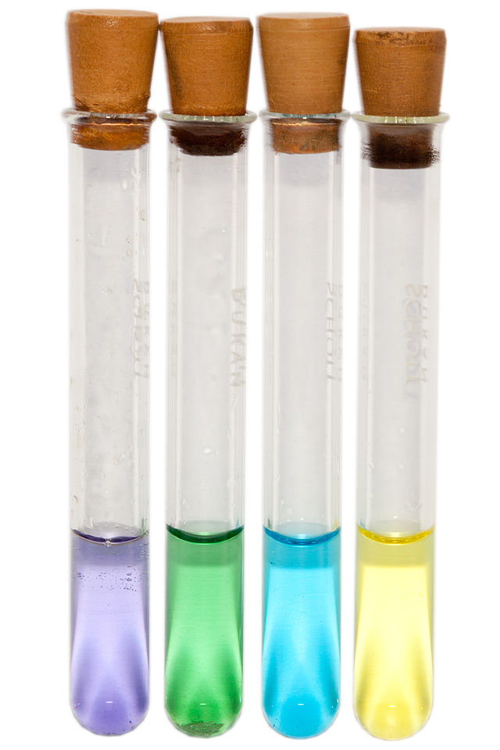
Multivalent Elements
9
-
2+
1+
29
Ionic charge
Elements with more that one possible ionic charge are called multivalent elements.
Only the most common ionic charges are written on your periodic tables
The most common charge written on top.
F
Cu
Fluorine
Copper
19.0
63.5
Ions of the same element with different charges can have very different properties.
V²⁺
V³⁺
V⁴⁺
V⁵⁺

Slide 11

How to Determine the
Chemical Formula for Ionic Compounds with Multivalent Metals
Chromium (III) nitride
Cr³⁺ and N³⁻
Cr³⁺ +3 = +3 1 Cr³⁺
N³⁻ -3 = -3 1 N³⁻
There is 1 Cr³⁺ for each 1 N³⁻.
Cr₃N₃
CrN
“Chromium three nitride”
Chemical equation, Cr³⁺ + N³⁻ → CrN
1. Identify each ion and their respective charges.
2. Determine the number of each ion needed to balance the positive and negative charges.
3. Note the ratio of positive and negative ions
4. Write the formula with the ratio in subscript numbers
A “1” is not written in the formula.
The ratio is typically simplified if possible.
$$\frac{3}{3}= \frac{1}{1}$$
3
+
3
-
Cross-Over rule
Cr
N
CrN

Slide 12
How to Determine
Chemical Name for Ionic Compounds with Multivalent Metals
Cu₃P
Cu, copper Cu⁺ ou Cu²⁺
P³⁻ 1(-3) = -3
Cu^{x} 3(x) = +3
x = +1
The copper ion in this compound is copper (I).
Copper (I) phosphide
1. Identify the metal and its possible ions.
2. Note the charge on the anion from the Periodic Table and determine the charge on the metal taking into account the number of each ion.
The positive and negative charges must balance.
Determine the positive charge needed to balance
4. Write the name of the compound with the cation first.

Slide 13
Utilizing the Cross-Over Rule in Reverse in order to Determine the Charge on the Multivalent Metal
Cu₂O
+
-
Cu
O
2
1
1
+
2-
2
1
Cu + O ↔ Cu₂O
In this case, copper (I) is present.
The name is, therefore, Copper (I) oxide.

Slide 14
Polyatomic Ions
Polyatomic ions are covalent compouds, molecules, that carry a charge.
Hydroxyde, OH⁻, is a polyatomic ion.
O
H
There are 9p and 10e in this compound, therefore the overall charge is -1.
Basically, for writing formulas and names,
TREAT POLYATOMIC IONS LIKE ANY OTHER ION.

Slide 15
Common Polyatomic Ions

Slide 16
How to Determine the
Chemical Name for Ionic Compounds with Polyatomic Ions
Al₂(SO₄)₃
Al³⁺ and SO₄²⁻
Aluminum sulfate
1. Identify each ion and their respective charges.
Tip - If you don’t find the element on the Periodic Table check the list of polyatomic ions.
2. Write the name of the compound with the cation first.

Slide 17
How to Determine the
Chemical Formula for Ionic Compounds with Polyatomic Ions
Ammonium phosphate
NH₄⁺ and PO₄³⁻
PO₄³⁻ 1(-3) = -3
NH₄⁺ x(1) = +3
x = 3
There are 3 NH₄⁺ for each 1 PO₄³⁻.
(NH₄)₃PO₄
Identify each ion and their respective charges.
Tip - If you don’t find the element on the Periodic Table check the list of polyatomic ions.
2. Determine the ratio of ions needed to balance the positive and negative charges.
The positive and negative charges must balance.
3. Write the name of the compound with the cation first.
Place brackets around polyatomic ions if more than one is needed.

Slide 18
In Order to Determine Chemical Formulas and Chemical Names with Polyatomic Ions, Follow the Same Steps.
Remember, TREAT THESE LIKE ANY OTHER ION.
Al₂(Cr₂O₇)₃
Al
+
(Cr₂O₇)
-
2
3
3+
2-
2
3
Al + Cr₂O₇ ↔ Al₂(Cr₂O₇)₃
Notice that the polyatomic ion’s, Cr₂O₇, formula is the same before and after the reaction.
The chemical name for Al₂(Cr₂O₇)₃ is
Aluminum dichromate

Slide 19




Names of Covalent Compounds
Covalent compound with two non-metals joins by on or more covalent bonds
Binary compound
DEET, C₁₂H₁₇NO
Water, H₂O
Tylenol, C₈H₉NO₂
Alcohol, C₂H₅OH
N,N-diethyl-m-toluamide
Dihydrogen monoxide
N-(4-hydroxyphenyl)acetamide
Ethanol

Slide 20
Naming Binary Covalent Compounds
N₂O₃
1. Name the first (leftmost) element in the formula
Nitrogen
2. Name the second element in the formula adding the suffix –ide.
Oxygen → oxide
3. Add prefixes to each element’s name indicating the number of atoms or each element in the compound
2 nitrogen → dinitrogen
3 oxides → trioxide
4. Write the name in the same order as the elements are written in the compound’s formula
dinitrogen trioxide

Slide 21
Summary
Ionic Compounds
Chemical name
Chemical formula
Roman numeral indicating the charge
on multivalent metal only.
Cation written first
Chromium (III) nitride
Cr₂N₃
Cation written first
Subscript numbers indicate the ratio between ions
Anion written second with the suffix -ide
Covalent Compounds
Chemical name
Chemical formula
Prefixes indicate the number of atoms of each element
Ratios of atoms are not simplified in covalent compounds as they are in ionic compounds
CS₂
Carbon disulfide
Second with the suffix -ide
No prefix if there is only one of the first element
Subscript numbers indicate the ratio between ions

