Slide 1
Chemical Names and Formulas of Compounds
PowerPoint 4.2

Slide 2
Reminder of Information in PowerPoint 4.1 and in PowerPoint 4.2
You should feel comfortable writing chemical names, determining chemical formulas, and utilizing both Bohr diagrams and Lewis diagrams.
Bohr diagram
Chemical name
Sodium chloride
+
-
Cl
Na
Chemical formula
NaCl
Lewis diagram
+
-
Chemical equation
Na⁺ + Cl⁻ → NaCl
Na
Cl

Slide 3
Chemical Equations
Chemical equations represent chemical reactions
One or more chemical changes occurring simultaneously.
2NO_{(g)} + O_{2(g)} $↔$ 2NO_{2(g)}
Symbolic equation,
Coefficient
Reactants
Products
State of matter
Word equation,
Copper (I) + oxygen $↔$ Copper (I) oxide

Slide 4
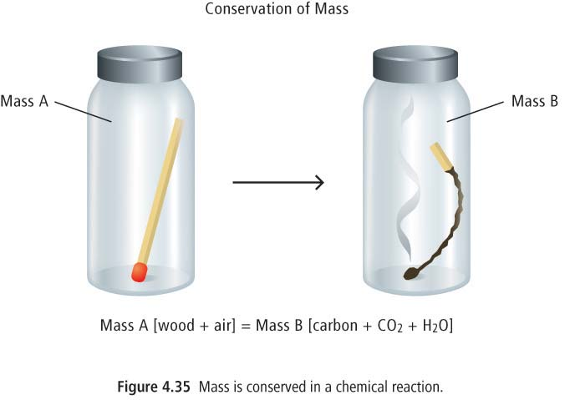
Law of Conservation of Mass
The total mass of the products is always equal to the total mass of the reactants in a chemical reaction
Atoms are neither created nor destroyed during a chemical reaction.

Slide 5
Various Forms of Chemical Equations
A word equation shows only the names for the reactants and products,
Methane + oxygen → water + carbon dioxide
A skeleton equation shows only the formulas for the reactants and products,
CH_{4(g)} + O_{2(g)} ↔ H₂O_{(g)} + CO_{2(g)}
A balanced equation shows the identities of each pure substance involved as well as the matching number of each element on both sides of the chemical equation.
CH_{4(g)} + 2O_{2(g)} ↔ 2H₂O_{(g)} + CO_{2(g)}

Slide 6
How to transform a Word equation into a skeleton equation
Word
Methane + oxygen → water + carbon dioxide
Naming binary covalent compounds
CO₂
CH₄
O₂
H₂O
Names of these compounds
must be memorized,
H₂O Water
CH₄ Methane
NH₃ Ammonia
HOFNBrICl
Naturally diatomic molecule
(H₂, N₂, O₂, S₂, F₂, Cl₂, Br₂, I₂)
CH₄ + O₂ → H₂O + CO₂
skeleton

Slide 7
Try transforming the following Word equation into a skeleton equation
Word
Hydrogen + nitrogen → ammonia
H₂
N₂
NH₃
Naturally diatomic molecule
(H₂, N₂, O₂, S₂, F₂, Cl₂, Br₂, I₂)
H₂ + N₂ → NH₃
skeleton

Slide 8
How to Transform a Skeleton Equation to a Balanced Equation
CH₄ + O₂ → H₂O + CO₂
2
2
Hints,
Count the total number of atoms on each side of the arrow
Recount as coefficients are added
Balance compounds first
Balance single elements last
Balance O and H last if on both sides
Polyatomic ions can often be counted as one unit instead of counting each element separately.
Utilize fractions to balance diatomic elements.
1
4
4
1
4
2
C
H
O
1
2
3
1
4
4

Slide 9
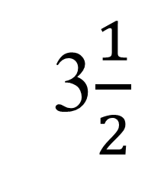
Try to Transform the Following Skeleton Equation into a Balanced Equation
3$\frac{1}{2}$
2
4
6
x 2
C₂H₆ + O₂ → CO₂ + H₂O
7
2
3
2
6
7
2
6
2
C
H
O
1
2
3
2
2
5
2
6
7

Slide 10
Summary
Reactants
Products
Word equation
Methane + oxygen → water + carbon dioxide
CH_{4(g)} + O_{2(g)} → H₂O_{(g)} + CO_{2(g)}
Skeleton equation
Balanced equation
Following the Law of conservation of mass
CH_{4(g)} + 2O_{2(g)} → 2H₂O_{(g)} + CO_{2(g)}

