Slide 1
Acids and Bases
PowerPoint 5.1

Slide 2
Classification of Elements
How many different ways are individual elements categorized?
Metals, non-metals, and metalloids.
Transition metals grouped together.
Lanthanoids and Actinoids, usually separated from the rest of the table.
By Group, alkali metals, halogens, noble gases, and so on.
By Period, indicating the number of shells of an element’s neutral atom.
Diatomic elements, H₂, N₂, O₂, S₂, F₂, Cl₂, Br₂, I₂

Slide 3
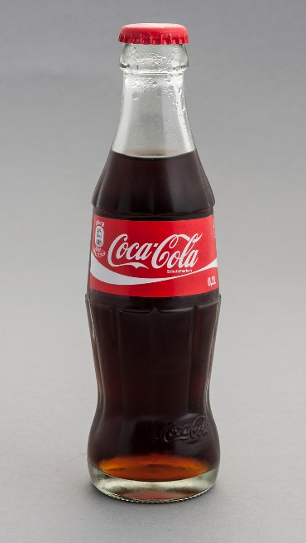
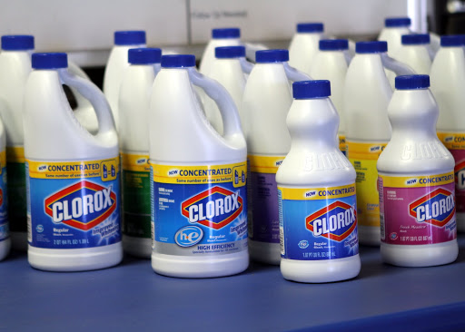
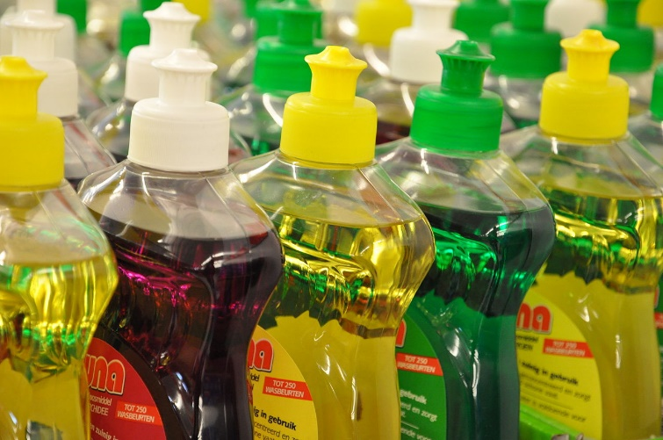
Classification of Compounds
How many different ways are individual compounds categorized?
Ionic compounds versus Covalent compounds
Acids and bases
Citrus fruits

Slide 4
General Differences between Acids and Bases
Acids
Sour taste
Corrosive, corrode metals
Formula generally begin with H or CH
Produces H⁺
pH < 7
Bases
Bitter taste
Slippery feel
Caustic
less reactive with metals
Formula generally ends with OH
Produces OH⁻
pH > 7
Both acids and bases
Corrosive
Conduct electricity

Slide 5
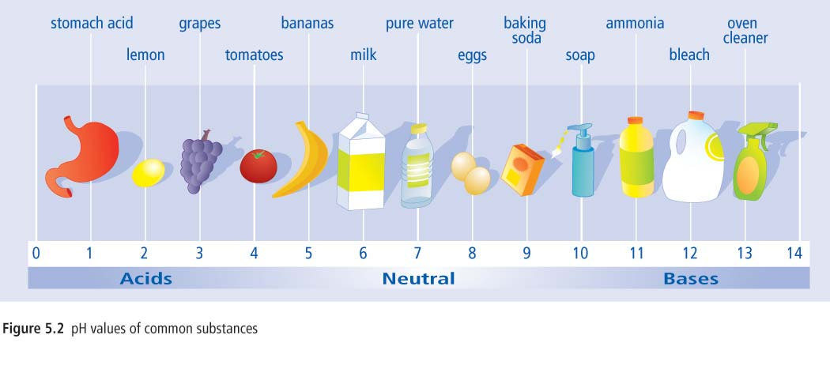
pH Scale
A scale from 0 to 14 utilized to indicate how acidic, or how basic, a substance is.
A change in one unit is actually a 10 times increase in acidity or basicity.
acidic
basic
or
alkaline

Slide 6
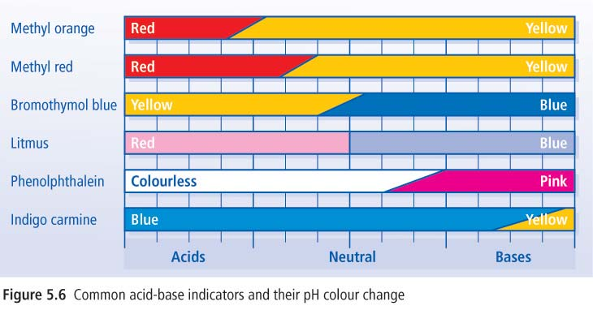
Acid-Base Indicators
Acid-Base indicators are chemical that change colour depending on the pH of a solution.
They are often utilized to determine the pH of a solution or to determine the concentration of H⁺ or OH⁻.

Slide 7
Names of Acids
Many ionic compounds create acidic solutions when dissolved in water
These compounds have different names when dissolved in water.
Formula Chemical name Formula in Solution Name in Solution
HF hydrogen fluoride HF_{(aq)} hydrofluoric acid
HCl hydrogen chloride HCl_{(aq)} hydrochloric acid
HBr hydrogen bromide HBr_{(aq)} hydrobromic acid
HI hydrogen iodide HI_{(aq)} hydriodic acid
H₂SO₄ hydrogen sulfate H₂SO_{4(aq)} sulfuric acid
H₂SO₃ hydrogen sulfite H₂SO_{3(aq)} sulfurous acid
HClO₄ hydrogen perchlorate HClO_{4(aq)} perchloric acid
HClO₃ hydrogen chlorate HClO_{3(aq)} chloric acid
HClO₂ hydrogen chlorite HClO_{2(aq)} chlorous acid
Suffix –ate → drop “hydrogen” and change –ate to –ic acid.
Suffix –ite → drop “hydrogen” and change –ite to –ous acid.

Slide 8
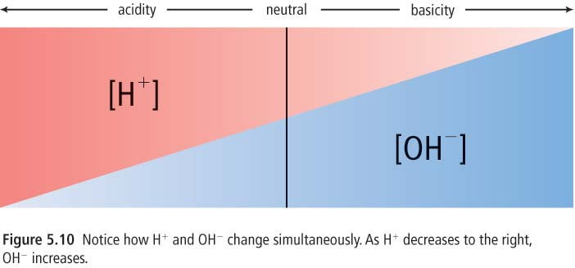
H⁺ and OH⁻ Ions
Acids produces H⁺ in solution
Bases produces OH⁻ in solution
As the concentration of H⁺,
acidity increases
OH⁻
H⁺
As the concentration of OH⁻,
basicity increases
+
→
H₂O
Neutralization
acid-base reaction

Slide 9
Summary
Acids
↑ concentration of H⁺
pH < 7
Neutralization reaction
Reaction between an acid and a base
H⁺ + OH⁻ → H₂O
Bases
↑ concentration of OH⁻
pH > 7
pH scale
acidic
basic
or
alkaline
Neutral
pure water

