Slide 1
Salts
PowerPoint 5.2

Slide 2
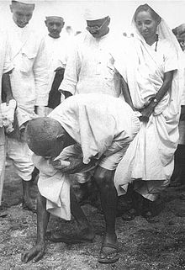
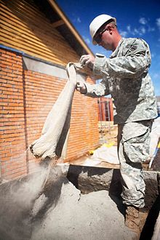
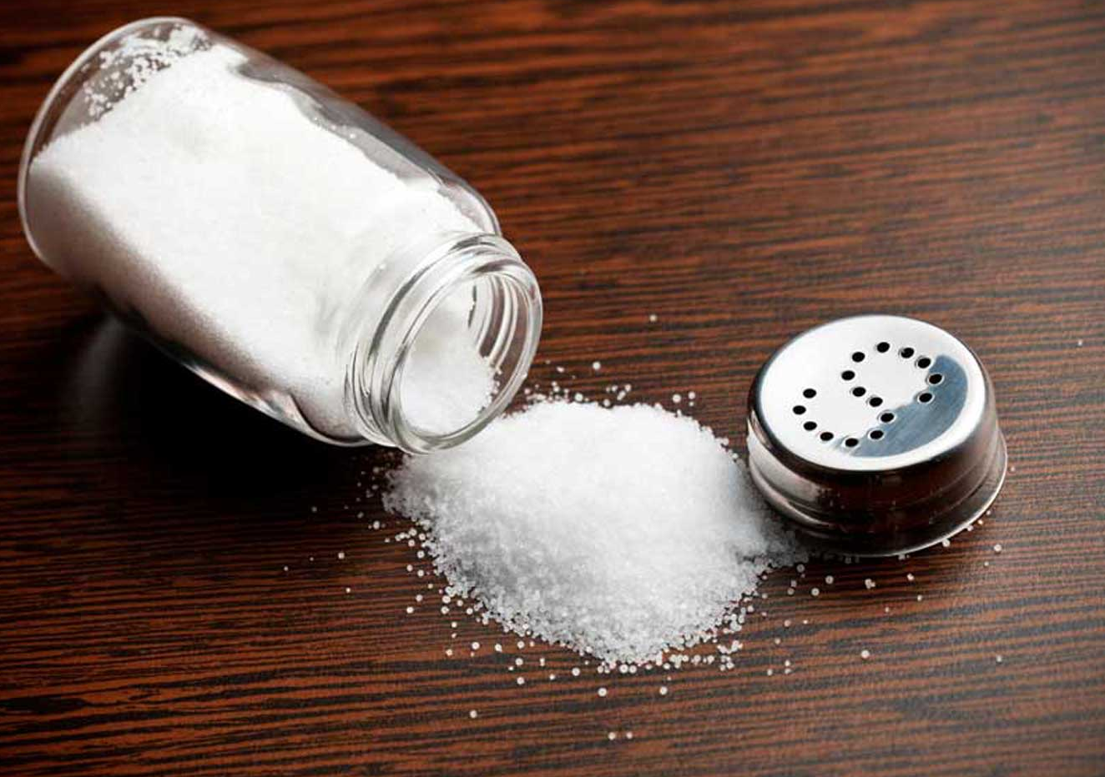
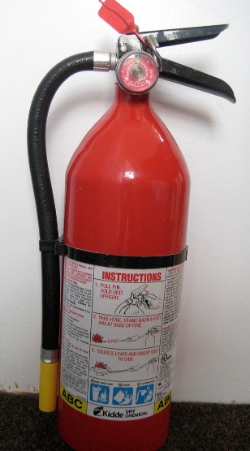
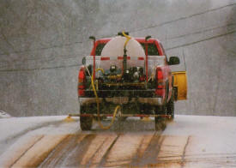
Classification of Compounds
How many different ways are individual compounds categorized?
Ionic compounds versus Covalent compounds
Acids and bases
Salts
CaSO₄
CaO
(NH₄)₂SO₄
CaCl₂
MgCl₂
NaCl, and KI and NaI

Slide 3
Salts
Salts are ionic compounds that can be formed during the chemical reaction between an acid and a base.
Acid + Base → Salt + Water
Example, HCl+ NaOH → NaCl + H₂O
Try writing the products of the following reactions,
H₂SO₄ + Al(OH)₃ →
3
2
6
Al₂(SO₄)₃ + H₂O
Acid + Base → Salt + Water
2
CH₃COOH + Mg(OH)₂ →
Mg(CH₃COO)₂ + H₂O
2
Acid + Base → Salt + Water

Slide 4
Other Reactions with Acids that Produce Salts
Metals react with acids to produce salts and hydrogen gas, H₂.
Acid_{(aq)} + Metal_{(s)} → Salt_{(aq)} + hydrogen_{(g)}
Example, HCl_{(aq)} + Mg_{(s)} →
MgCl_{2(aq)} + H_{2(g)}
2
Carbonates react with acids to produce salts and hydrogen gas, H₂.
Acid + Carbonate → Salt + water + carbon dioxide
Example, H₂SO₄ + CaCO₃ →
CaSO₄ + H₂O + CO₂

Slide 5
Oxides
An oxide is a compound that contains at least one oxygen atom or ion along with one or more other elements.
Metal oxides contain oxygen bonded to a metal.
When placed in water, metal oxides form basic solutions.
Na₂O_{(s)} + H₂O_{(l)} → 2NaOH_{(aq)}
Metal oxide + water → basic solution
Non-metal oxides contain oxygen bonded to a non-metal.
When placed in water, non-metal oxides form acidic solutions.
2SO_{2(s)} + H₂O_{(l)} → 2H₂SO_{3(aq)}
Non-metal oxide + water → acidic solution
Acid rain can from non-metal oxides and water,

Slide 6
Summary
Reactions involving acids and bases
Acid + Base → Salt + Water
Neutralization reaction
Acid_{(aq)} + Metal_{(s)} → Salt_{(aq)} + hydrogen_{(g)}
Metal and acid reaction
Acid + Carbonate → Salt + water + carbon dioxide
Carbonate and acid reaction
Metal oxide + water → basic solution
Metal oxide and water
Non-metal oxide + water → acidic solution
Non-metal oxide and water

