Slide 1
Organic Compounds
PowerPoint 5.3

Slide 2
Organic Chemistry
Organic Chemistry is the study of chemical compounds that contain carbon.
Most organic compounds also contain hydrogen.
In general, not all compounds that contain carbon are classified as organic compounds.
Various Organic Compounds |  | Inorganic Compounds Containing Carbon
CH₄ | Methane | CaCO₃ | carbonates
CH₃CH₂OH | Ethanol | Na₂CO₃
C₆H₅COOH | Benzoid acid (an organic acid) | Al₄C₃ | Carbides
K₂HC₆H₅O₇ | Potassium citrate (an organic salt) | SiC
C₈H₁₀N₄O₂ Caffeine C₁₀H₁₅N Methamphetamine C₁₀H₁₅N·HCl Crystal meth | Stimulant drugs | CO CO₂ | Oxides
CH₃(CH₂)_{n}CH₃ Polyethylene (CH₂CHCl)_{n} Poly(vinyl chloride), | plastics | Inorganic Not Containing Carbon
C₆H₁₂O₆ Glucose | Various nutrients | FeCl₂, (NH₄)₂SO₃, HCl, NaCl, H₂S

Slide 3
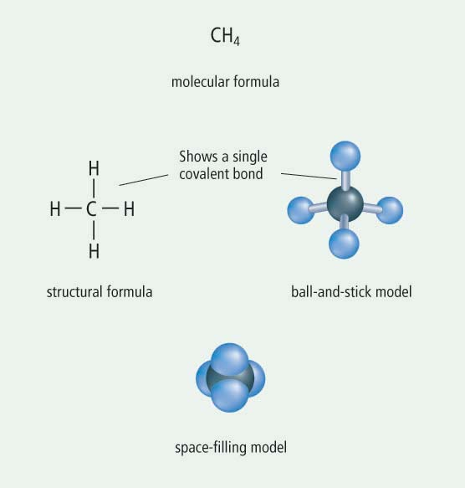
Organic Compounds
Representations of organic compounds
C is generally written first in an organic compounds formula
Writing H first would imply that they are acids
Some Types of Organic Compounds
Hydrocarbons Contain only C and H
CH₄ methane
CH₃CH₃ ethane
CH₃CH₂CH₃ propane
CH₃CH₂CH₂CH₃ butane
Alcohols Contain only C, H, and O
CH₃OH methanol
CH₃CH₂OH ethanol
CH₃CH₂CH₂OH propanol or isopropanol

Slide 4
Summary
Organic compounds contain carbon
However, carbides, carbonates, and oxides are not generally classified as organic compounds
Organic compounds can be drawn in a number of ways.
Methane
Chemical name

