Slide 1
Factors Affecting the Rate of Chemical Reactions
PowerPoint 6.2

Slide 2
Rate of Reaction
The rate of reaction is how quickly or slowly reactants turn into products.
Four ways to control the rate of reaction,
Temperature
Concentration
Surface area
Catalyst

Slide 3
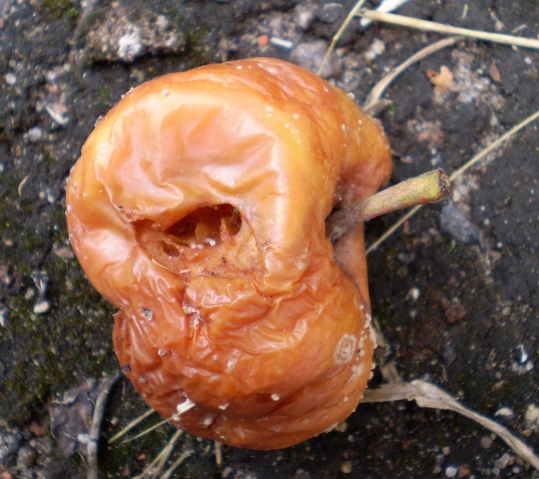
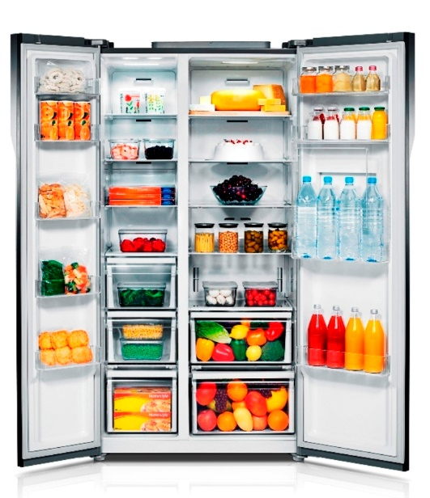
1. Temperature
Temperature
Movement of particles
Reaction between particles
Temperature
Movement of particles
Reaction between particles

Slide 4
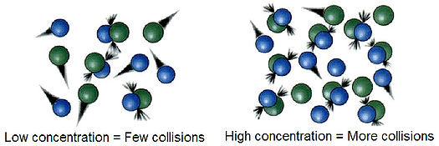
2. Concentration
With a greater concentration of reactants, there is a greater chance that collisions among them will occur.

Slide 5
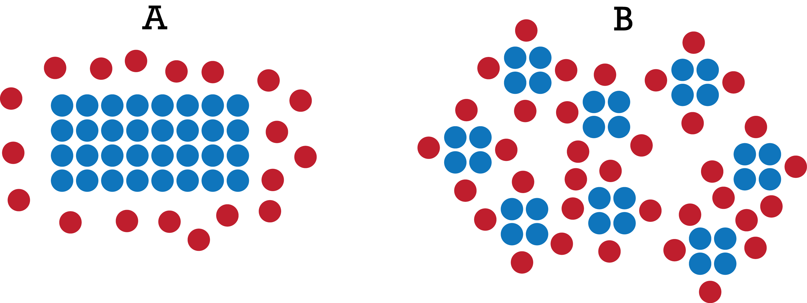
3. Surface Area
Low surface area
High surface area
Surface area
Collisions frequency between reactants
Reaction rate
Example, burning logs versus burning saw dust.

Slide 6
4. Catalyst
A catalyst is a substance that speeds up the rate of a chemical reaction without being used up in the reaction itself
A catalyst generally is not included directly when we write the chemical equation of a reaction
Vital example → enzymes

Slide 7
Summary
Factors that influence reaction rates
1. Temperature
Reaction rates increase as temperature increases
2. Concentration
Reaction rates increase as concentration increases
3. Surface area
Reaction rates increase as surface area increases
4. Catalyst
Catalysts facilitate the interaction of reactants and increase reaction rates

