Slide 1
Atomic Theory, Isotopes, and Radioactive Decay
PowerPoint 7.1

Slide 2
Isotopes
Isotopes are atoms of a particular element that have the same number of protons but different numbers of neutrons.
Isotopes are often written in standard atomic notation.
Also called the nuclear symbol
Mass number = #p + #n
$${}_{19}^{39}K$$
Other isotopes of potassium
Chemical symbol
Nuclear charge = #p
$${}_{19}^{40}K$$
$${}_{19}^{41}K$$
The name of this isotope is Potassium-39

Slide 3
Isotopes of Potassium
 | Potassium-39 | Potassium-40 | Potassium-41
# of protons | 19 | 19 | 19
# of neutrons | 20 | 21 | 22
# of total electrons In a neutral atom | 19 | 19 | 19

Slide 4
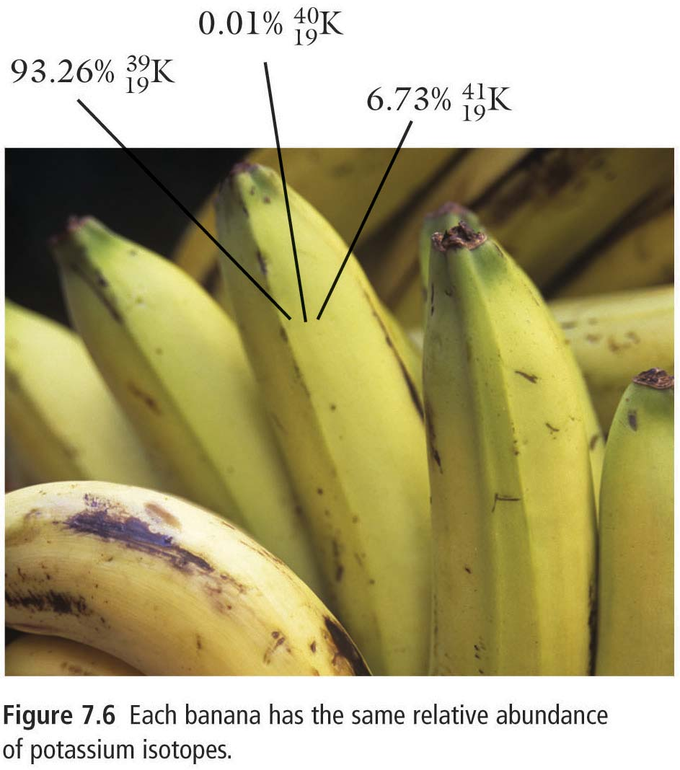
Why Are Atomic Masses on the Periodic Table of Elements Often Decimals?
The atomic mass cited in the Periodic Table of Elements is actually an average the element’s isotopes’ masses based on their relative abundance.
19
-
K
chlorine
39.09835
For potassium,
93.3% is ${}_{19}^{39}K$,
6.73% is ${}_{19}^{41}K$, and
0.01% is ${}_{19}^{40}{K.}$

Slide 5
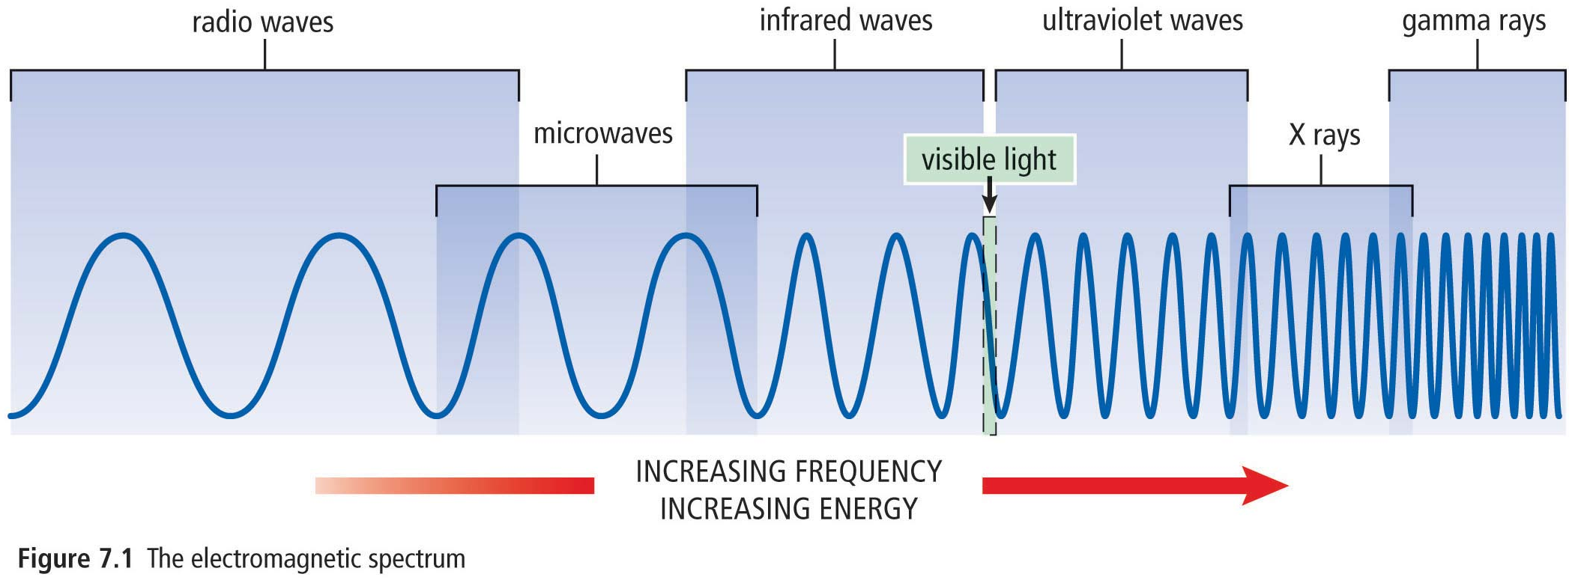
Radioactivity and Radiation
Radioactivity is the release of high-energy particles and rays of energy from a substance as a result of changes in the nuclei of its atoms.
Radiation refers to high-energy rays and particles emitted by radioactive sources.

Slide 6
Radioactive Decay
Radioactive decay is the process in which unstable nuclei lose energy by emitting radiation.
Radioactive decay typically continues in a particular atom until a stable, non-radioactive isotope form is obtained.
Radioisotopes are isotopes that can undergo radioactive decay.
Three types of radioactive decay are,
Alpha decay, α
Beta decay, β
Gamma radiation, γ

Slide 7
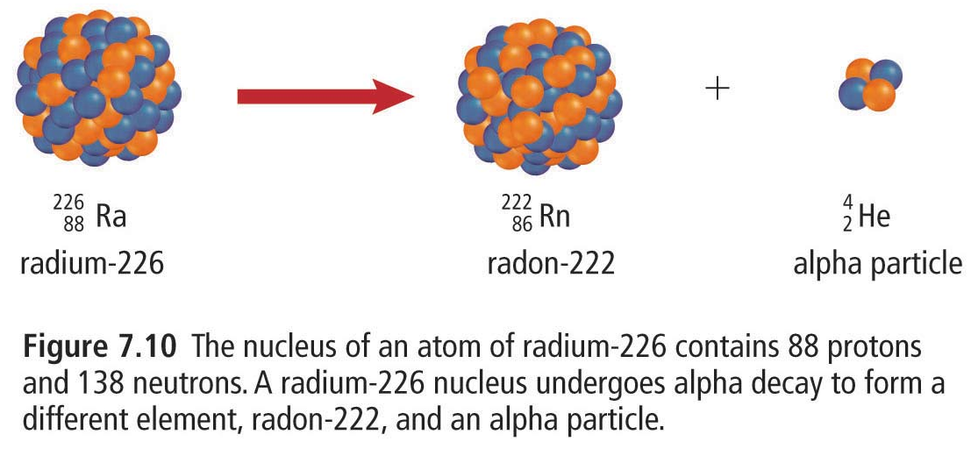
Alpha Decay
Alpha decay is the emission of an alpha particle, ${}_{2}^{4}α$ or ${}_{2}^{4}{He}$, from the nucleus of an atom.
.${}_{88}^{226}{Ra→ {}_{86}^{222}{Rn+ {}_{2}^{4}α}}$
The total number of protons and neutrons before and after the reaction are equal.
The element has changed into a different element, ${}_{88}^{226}{Ra}$ → ${}_{86}^{222}{Rn}$

Slide 8
Beta Decay
Mass of an electron is ≈ 0
Charge of an electron = -1
The emission of a beta particle which is an electron which written ${}_{−1}^{0}β$or ${}_{−1}^{0}e.$
.${}_{53}^{131}{I → {}_{54}^{131}{Xe+ {}_{−1}^{0}β}}$
During beta decay, a neutron changes into a proton and an electron,
The proton remains inside the nucleus while the electron is emitted with great energy.
Note that the mass of an atom undergoing beta decay remains the same.

Slide 9
Gamma Decay
Gamma radiation, ${}_{0}^{0}γ$, consists of high-energy, short-wavelength radiation.
Example, ${}_{28}^{60}{Ni→ {}_{28}^{60}{Ni+ {}_{0}^{0}γ}}$
Gamma radiation can accompany other types of radiation, such as alpha radiation.
Example, ${}_{92}^{238}{U→ {}_{90}^{234}{Th+ {}_{2}^{4}{α+2{}_{0}^{0}γ}}}$

Slide 10
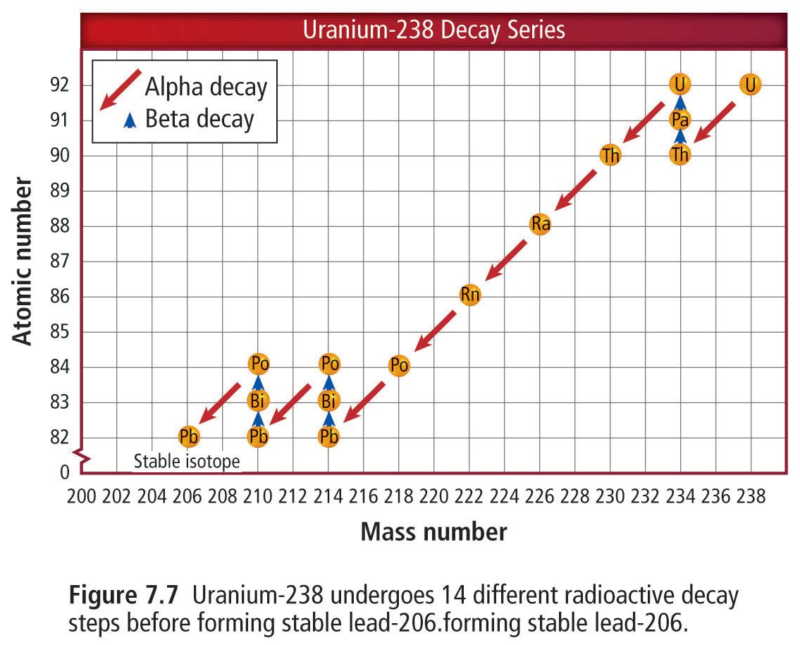
Some Isotopes Can Undergo Numerous Decays Until a Stable Form Is Obtained

Slide 11
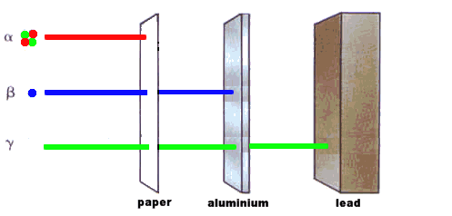
Relative Penetrating Power of Alpha Radiation, Beta Radiation, and Gamma Radiation

Slide 12
Summary
Isotopes of an element have varying quantities of neutrons
Radioisotopes undergo various forms of radioactive decay such as Alpha, Beta, and Gamma.
Property | Alpha Radiation | Beta Radiation | Gamma Radiation
Symbol | ${}_{2}^{4}α$ or ${}_{2}^{4}{He}$ | ${}_{−1}^{0}β$or ${}_{−1}^{0}e$ | $${}_{0}^{0}γ$$
Composition | Alpha particle | Beta-particle | High-energy electromagnetic radiation
Description of the radiation | Helium nucleus | electron | High energy rays
Charge of the emission | 2+ | 1- | 0
Relative Penetrating Power | Blocked by paper | Blocked by metal foil or concrete | Partly blocked or completely blocked by lead

