Slide 1
Half-life
PowerPoint 7.2

Slide 2
Answer these questions in your group
1. For ${}_{53}^{131}{I },$
a. What is its name?
b. How many protons and neutrons does it have?
c. What is its mass?
2. a. If ${}_{53}^{131}{I }$ underwent alpha decay, what would be produced?
b. Write the nuclear equation.
3. a. If ${}_{53}^{131}{I }$underwent beta decay, what would be produced?
b. Write the nuclear equation.
4. a. If ${}_{53}^{131}{I }$* underwent gamma decay, what would be produced?
b. Write the nuclear equation.
5. What is the relative penetrating power of α, β, and γ decay?
Iodine-131
131 – 53 = 78
53p, 78n
131 a.m.u.
$${}_{51}^{127}{Sb+ {}_{2}^{4}α}$$
$${}_{53}^{131}{I → {}_{51}^{127}{Sb+ {}_{2}^{4}α}}$$
$${}_{54}^{131}{Xe+ {}_{−1}^{0}β}$$
$${}_{53}^{131}{I → {}_{54}^{131}{Xe+ {}_{−1}^{0}β}}$$
$${}_{53}^{131}{I+ {}_{0}^{0}γ}$$
$${}_{53}^{131}{I^{∗} → {}_{53}^{131}{I+ {}_{0}^{0}γ}}$$
γ > β > α

Slide 3
Review of PowerPoint 7.1
Parent isotope
Daughter isotope
$${}_{88}^{226}{Ra→ {}_{86}^{222}{Rn+ {}_{2}^{4}α}}$$
Alpha decay
$${}_{53}^{131}{I → {}_{54}^{131}{Xe+ {}_{−1}^{0}β}}$$
Beta decay
$${}_{28}^{60}{Ni→ {}_{28}^{60}{Ni+ {}_{0}^{0}γ}}$$
Gamma decay

Slide 4
Half-life
A half-life is the time needed for 50% of a particular isotope in a sample to decay.
Example, ${}_{6}^{14}C$ → ${}_{7}^{14}{N+ {}_{−1}^{0}β}$
If we begin with 40 g of carbon-14, the time it takes for 20 g to decay to nitrogen-14 is the half-life of carbon-14.
For C-14, this timeframe happens to be 5730 years.
Therefore, the half-life of ${}_{6}^{14}C$ is 5730 years.
Different isotopes of different elements have different half-lives.
Beta decay

Slide 5
Half-Lives of Various Isotopes
Isotope Half-life
Isotope Half-life
Hydrogen-7 2.1 x 10⁻²³ seconds
Lithium-11 0.00859 seconds
Lithium-8 0.8399 seconds
Seaborgium-266 30 seconds
Nobelium-259 58 minutes
Iodine-131 8.02 days
Chromium-51 27.7025 days
Sulfur-35 87.32 days
Californium-248 333.5 days
Strontium-90 28.79 years
Carbon-14 5730 years
Plutonium-240 6563 years
Plutonium-239 24 110 years
Lead-202 52 500 years
Iron-60 1 500 000 years
Uranium-235 710 000 000 years
Potassium-40 1 300 000 000 years
Uranium-238 4 500 000 000 years
Thorium-235 14 000 000 000 years
Robidium-87 47 000 000 000 years
710 000 000 years = 710 Ma

Slide 6
Radioactive decay of C-14 Half-life = 5730 years
Number of Half-lives | Time Elapsed (years) | Percent of Carbon-14 Remaining | Mass of Carbon-14 Remaining
0 | 0 | 100% | 40 g
5730
(1 x 5730)
$\left(\frac{1}{2} x 40 g\right)$ = 20 g
1
50%
11460
(2 x 5730)
$\left(\frac{1}{2} x \frac{1}{2} x 40 g\right)$ = 10 g
2
25%
17190
(3 x 5730)
$\left(\frac{1}{2} x \frac{1}{2} x \frac{1}{2} x 40 g\right)$= 5 g
3
12.5%
22920
(4 x 5730)
$\left(\frac{1}{2} x \frac{1}{2} x \frac{1}{2} x \frac{1}{2} x 40 g\right)$= 2.5 g
4
6.25%

Slide 7
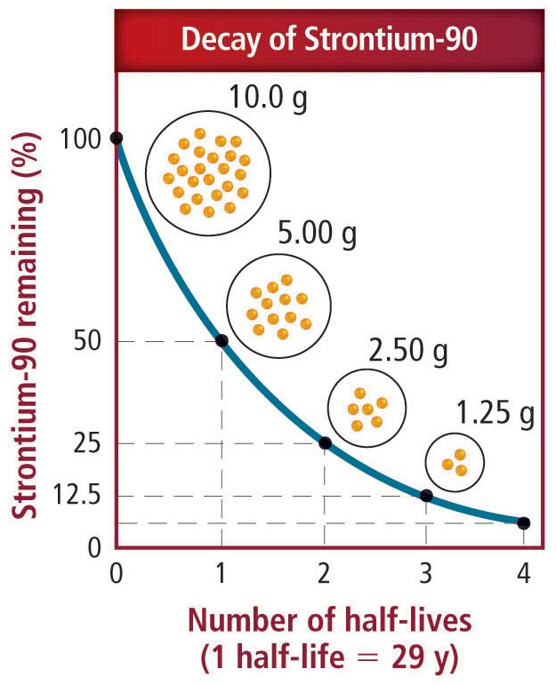
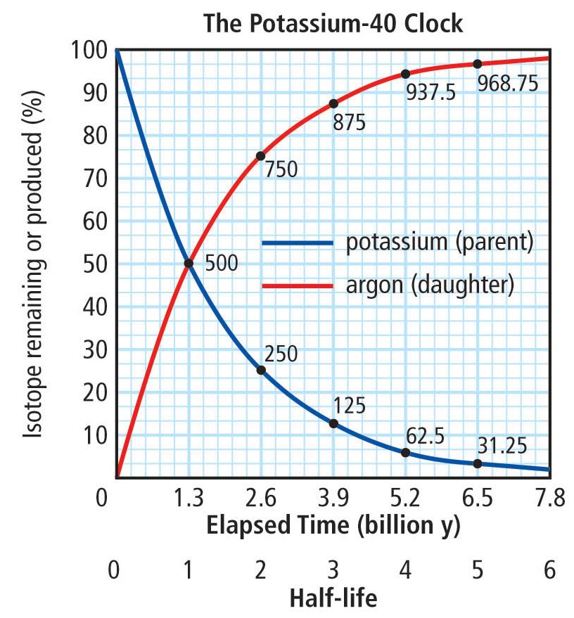
Decay Curve
A decay curve is a curved line on a graph that shows the rate at which radioisotopes decay.
The decay curve of each radioisotope parent will look the same, with the exception of the length of their respective half-lives.
The plot of the presence of the daughter isotope shows how the abundance of the daughter isotope increases as that of the parent isotope decreases.

Slide 8
Radioisotope Dating
Radioisotope dating is utilized to determine the age of objects based on the relative abundance of parent and daughter isotopes.
Different radioisotopes are useful in determining the age of objects of different ages.
Isotope |  | Half-Life of Parent (years) | Effective Dating Range (years)
Parent | Daughter
Carbon-14 | Nitrogen-14 | 5730 | Up to 50 000
Uranium-235 | Lead-207 | 710 000 000 | > 10 000 000
Potassium-40 | Argon-40 | 1 300 000 000 | 10 000 to 3 000 000 000
Uranium-238 | Lead-206 | 4 500 000 000 | > 10 000 000
Thorium-235 | Lead-208 | 14 000 000 000 | > 10 000 000
Radiocarbon dating

Slide 9
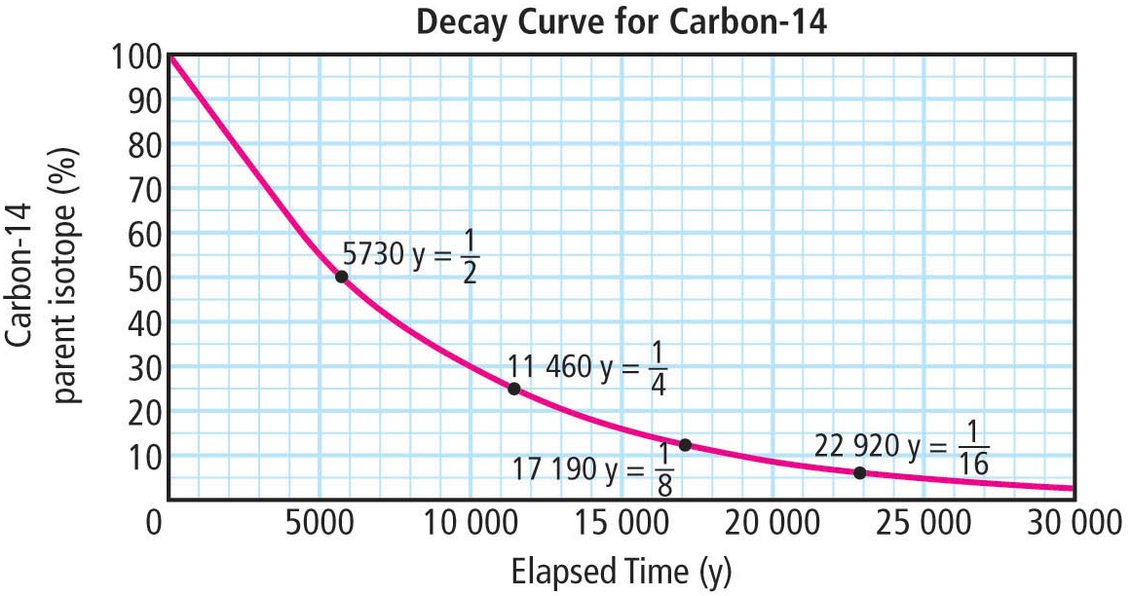
Principles Behind Radioisotope Dating
Radiocarbon dating is typically utilized to date organisms.
The abundance of C-14 in living organisms remains relatively constant while it is alive but decreases after it dies.
C-14’s effective dating range is based on the fact that, after 50 000 years, very little C-14 will remain making its detection quite difficult.
Potassium-40 dating is typically utilized to date rocks and minerals.
The abundance of K-40 decreases after molten rock solidifies after which it begins to form Ar-40 gas which becomes trapped in the rock.

Slide 10
Other Uses of Radioisotopes Based on Their Respective Half-Lives
research, diagnose, and treat disease
sterilize medical equipment
trace processes in living organisms
preserve food
detect smoke
analyze pollutants
detect weakness in metal structures
analyze minerals and fuels
study the movement of water
measure ages of rocks and remains of plants and animals

Slide 11
Provincial Exam Question
Question,
A rock sample originally contained 8 g of U-235 but now contains only 2 g of U-235. How old is the rock?
A. 710 Ma B. 1420 Ma C. 2130 Ma D. 2840 Ma
Answer,
The half-life of Uranium-235 is 710 000 000 years.
How many half-lives have past?
$$\frac{8}{2}=4$$
1 half-life,
2 half-lives having past mean that
1 420 000 000 years have past since this rock formed,
Therefore the answer is B.
$$\frac{4}{2}=2$$
2 half-lives,
2 x 710 000 000

Slide 12
Provincial Exam Question
Question,
A sealed container contains 200 g of radioactive iodine. After 24 days, the container has only 25 g of radioactive iodine. What is the half-life of this isotope of iodine?
A. 3 days B. 8 days C. 12 days D. 24 days.
Answer,
How many times has the original 200 g been divided in half to get to 25 g?
$$\frac{200}{2}=100 g$$
$$\frac{100}{2}=50 g$$
$$\frac{50}{2}=25 g$$
1 half-life,
2 half-lives,
3 half-lives,
In 24 days, 3 half-lives have past, therefore each half-life is B,
$$\frac{24}{3}=8 days.$$

Slide 13
Summary
A half-life is the time needed for 50% of a particular isotope in a sample to decay from the parent isotope to the daughter isotope.
The reduction in the abundance of a particular
radioisotope can be shown in a decay curve.
Utilizing known half-lives, one can determine
the age of living and non-living materials.

