Slide 1
Nuclear Reactions
PowerPoint 7.3

Slide 2
Chemical Reactions Versus Nuclear Reactions
Chemical Reactions
Relatively small amount of energy involved
Rearrangement of valence electrons
Atomic nuclei are unchanged
Nuclear Reactions
Large amounts of energy involved
Nuclei of isotopes are changed often producing different elements
Electrons can be produced in the nucleus
Beta decay
-
-
2+
$${}_{−1}^{0}{β }$$
Be
F
F
$${}_{53}^{131}{I }$$
$${}_{54}^{131}{Xe}$$

Slide 3
Review of Symbols for Subatomic Particles in Standard Atomic Notation
Particle | Also Known As | Symbols
Proton | H nucleus | $${}_{1}^{1}{p or {}_{1}^{1}{H }}$$
Neutron | - | $${}_{0}^{1}{n }$$
Electron | Beta particle | $${}_{−1}^{0}{e or {}_{−1}^{0}β}$$
Alpha particle | He nucleus | $${}_{2}^{4}{α or {}_{2}^{4}{He }}$$

Slide 4
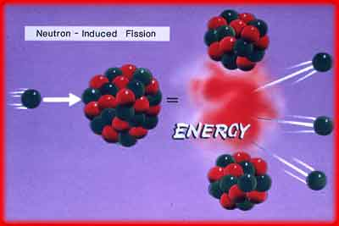
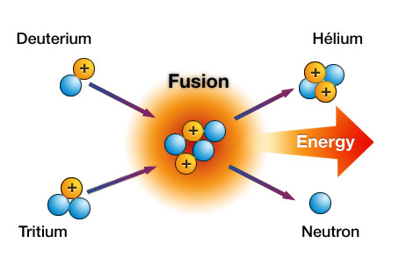
Two Types of Nuclear Reactions
1. Nuclear Fission
Both types of reactions can be
induced.
2. Nuclear Fusion

Slide 5
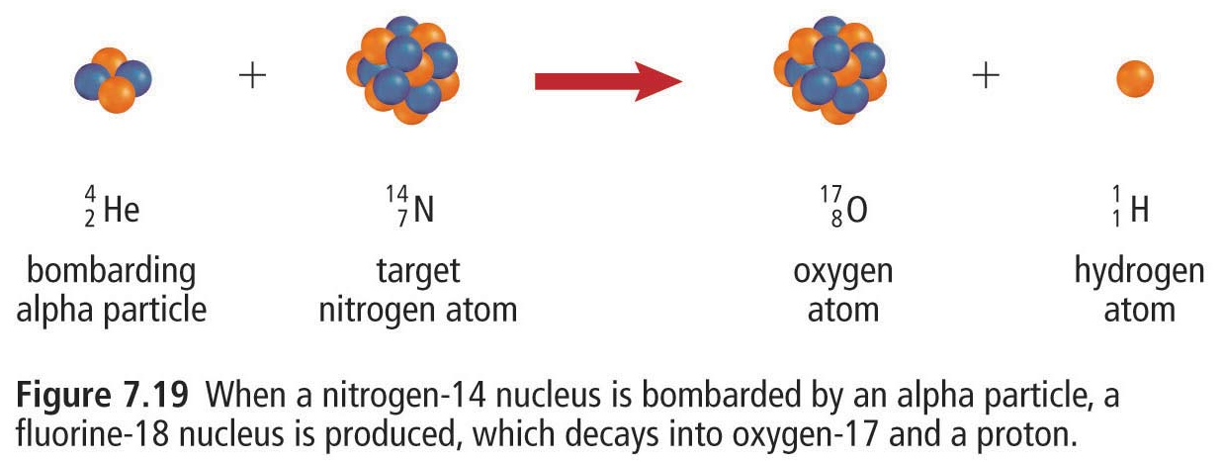
Induced Nuclear Reactions
Naturally occurring nuclear reactions are generally caused by unstable nuclei.
Scientists can also cause nuclei of isotopes to become unstable, causing an immediate nuclear reaction.
α, β, and γ decay
Induced Nuclear Reaction
Induced nuclear
fusion

Slide 6
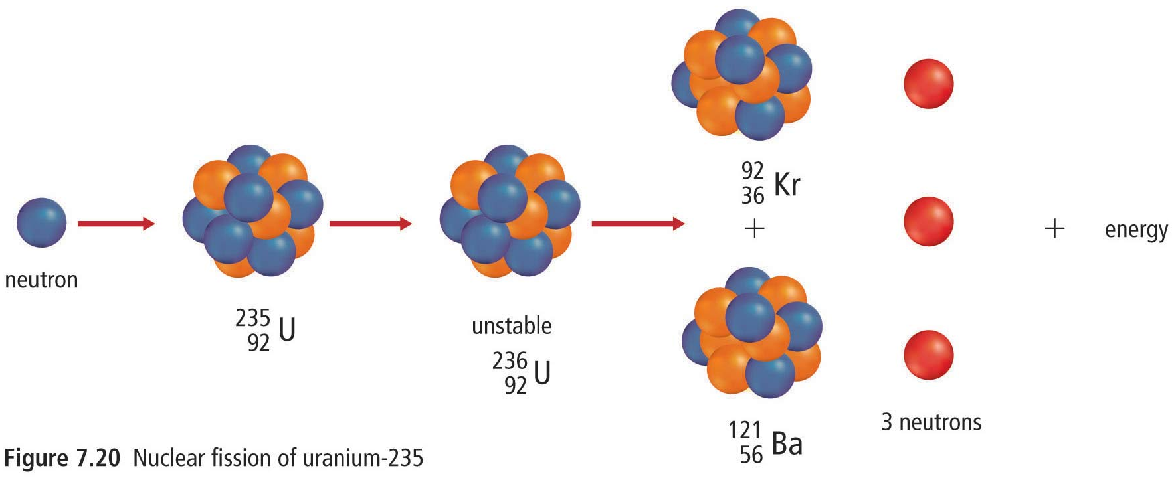
A More Common Induced Nuclear Reaction The Induced Nuclear Fission of U-235
$${}_{0}^{1}{n+}{}_{92}^{235}{U → {}_{36}^{92}{Kr+ {}_{56}^{141}{Ba+3}}}{}_{0}^{1}{n+energy}$$
This is a nuclear reaction that is commonly utilized to produce nuclear power in Canada, in CANDU reactors.

Slide 7
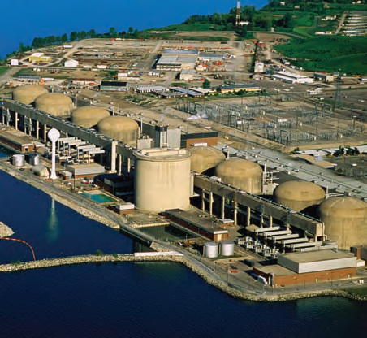
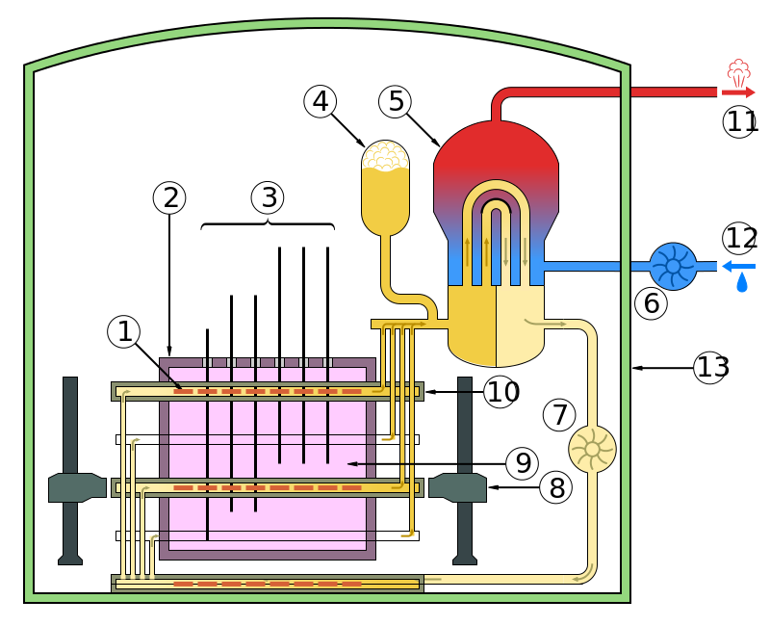
Canadian Deuterium Uranium Reactors, CANDU Reactors
A CANDU reactor in Pickering, Ontario
Inside a CANDU nuclear reactor
$${}_{0}^{1}{n+}{}_{53}^{131}{I → {}_{36}^{92}{Kr+ {}_{56}^{141}{Ba+3}}}{}_{0}^{1}{n+energy}$$

Slide 8
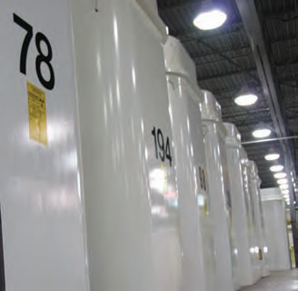
CANDU Reactors are great, But
Nuclear materials, U-235, are only useable for approximately 15 years.
Eventyally, the nuclear waste left over is stored in above-ground storage tanks.
While the radioactivity of used fuel bundles decreases significantly with time, the bundles remain hazardous for many thousands of years and must be isolated from the natural living environment

Slide 9
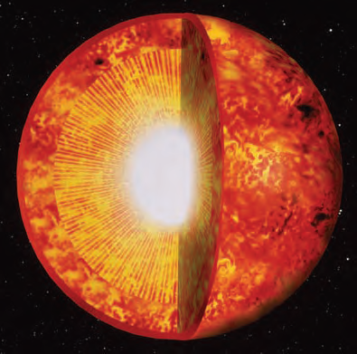
Nuclear Fusion
Fusion is the process in which two low mass nuclei join together to make a more massive nucleus.
Fusion occurs naturally in the extremely high-temperature and high-pressure cores of stars like the Sun.
$${}_{1}^{3}{H+}{}_{1}^{2}{H → {}_{2}^{4}{He+ }}{}_{0}^{1}{n+energy}$$

Slide 10
Key Points for Nuclear Reaction Equations
$${}_{0}^{1}{n+ {}_{92}^{235}{U → {}_{60}^{152}{Nd+ {}_{32}^{80}{Ge}+4 {}_{0}^{1}n}}}$$
1. The total masses before and after the reaction are the same.
Law of conservation of mass
In the reaction above,
mass number on the left = 1 + 235 = 236
mass number on the right = 152 + 80 + (4 x 1) = 236
2. The net charge before and after the reaction is the same.
Law of conservation of charge
In the reaction above,
charge on the left = 0 + 92 = 92
charge on the right = 60 + 32 + (4 x 0) = 92

Slide 11
Provincial Exam Question
Question
Which reaction occurs when an alpha particle is captured by a beryllium-9 nucleus?
A. ${}_{4}^{9}{Be+ {}_{2}^{4}{He → {}_{6}^{12}{C+ {}_{0}^{1}n}}}$
B. ${}_{4}^{9}{Be+ {}_{2}^{4}{He → {}_{12}^{6}{C+ {}_{1}^{0}n}}}$
C. ${}_{4}^{9}{Be+ {}_{2}^{4}{He → {}_{12}^{6}{Mg+ {}_{1}^{0}n}}}$
D. ${}_{4}^{9}{Be+ {}_{2}^{4}{He → {}_{6}^{12}{Mg+ {}_{0}^{1}n}}}$
Answer
The total mass on the left is 9 + 4 = 13.
Options A and D have a total mass of 13 on the right, but only A shows the correct element for a nucleus with 6 protons, therefore the answer is
A. ${}_{4}^{9}{Be+ {}_{2}^{4}{He → {}_{6}^{12}{C+ {}_{0}^{1}n}}}$

Slide 12
Provincial Exam Question
Question
What type of reaction is occurring?
${}_{83}^{209}{Bi+ {}_{28}^{64}{Ni → {}_{111}^{272}{Rg+ {}_{0}^{1}n}}}$
A. fusion
B. fission
C. beta decay
D. alpha decay
Answer
Bi and Ni have joined to form a larger isotope, Rg. Even though a neutron is expelled, two smaller isotopes joining together to form a larger isotope is fusion, therefore the answer is A.

Slide 13
Provincial Exam Question
Question
Which of the following subatomic particles completes the nuclear reaction below?
${}_{92}^{235}{U+ {}_{0}^{1}{n → {}_{38}^{94}{Sr+ {}_{54}^{140}{Xe}}}}$ +
one proton
two protons
one neutron
two neutrons
Answer
The total mass on the left is 235 + 1 = 236, therefore the mass on the right must also be 236. The mass of whatever is missing must be 236 – 94 – 140 = 2.
The total charge on the left is 92, therefore the total charge on the right must also be 92. The mass of whatever is missing must be 92 – 38 – 54 = 0.
The option that has a mass of 2 and a charge of 0 is D.

Slide 14
Summary
Induced nuclear reactions can be caused by bombarding nuclei with high-energy particles causing them to become unstable.
Types of nuclear reactions
fission, utilized in CANDU reactors, nuclear bombs, and other applications
fusion, occurring in stars and, maybe one day, on earth to produce energy

