Slide 1
The Language of Motion
PowerPoint 8.1

Slide 2
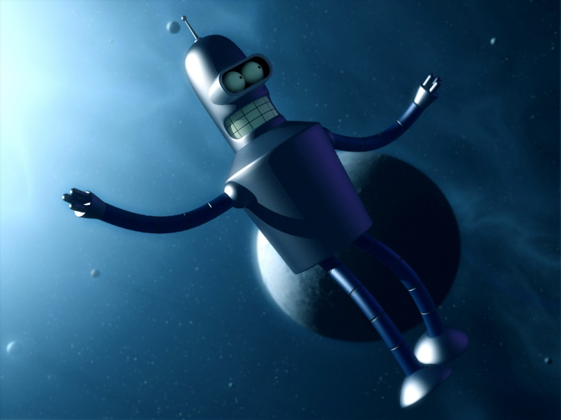
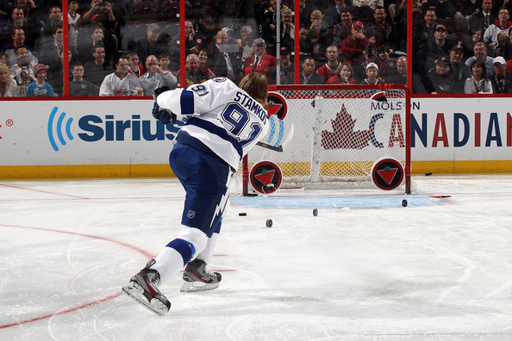
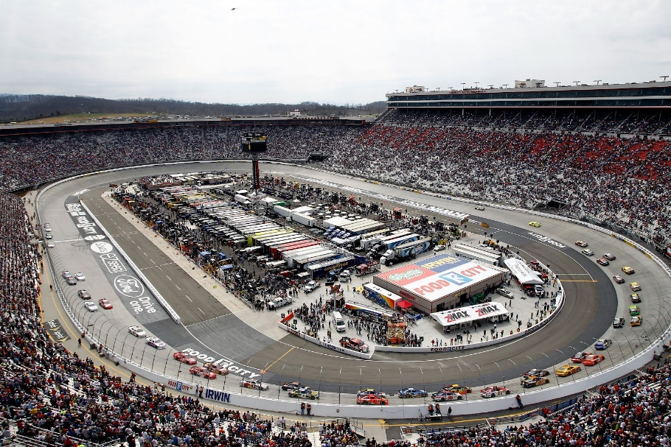
How would you describe the motion in each of the images below?
Motion of the something floating through space
Motion of the pucks
Motion of the cars

Slide 3
Size does matter, but so does direction
The size of a measurement or the amount (number).
Quantities that describe magnitude but do not include direction are called scalar quantities or scalars.
Ex. I live 7 km from here.
Quantities that describe magnitude and also include direction are called vector quantities or vectors.
Ex. I live 7 km east from here.
Often written as 7km [E].

Slide 4
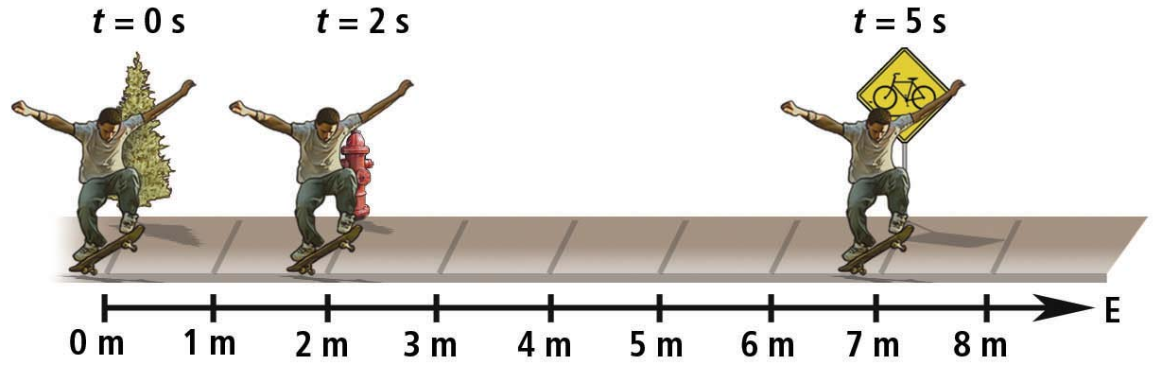
Time
Time, $t$, is classified as a scalar quantity.
Time interval, $Δt$, is also a scalar quantity.
The skateboarder passes the firehydrant at t = 2 s.
The skateboarder travels 5 m in the time interval,
Δt = (5 s) – (2 s) = 3 s.
Change in time = $Δt= t_{f} − t_{i}$
Final time
initial time

Slide 5
Distance, Position, and Displacement – not the same thing
Distance, $d$, describes the length of a path between two points.
Position, $\overset{⃑}{d}$, describes a specific point relative to a point of reference.
Displacement, $Δ\overset{⃑}{d}$, is the straight-line distance and direction from one point to another, and it describes a change in position.
$$d=9 m$$
$$\overset{⃑}{d}= 17 m to the right$$
$$Δ\overset{⃑}{d}= d_{f}− d_{i}=\left(−4 m\right)−\left(17 m\right)=−21 m$$
-4 m
0 m
9 m
17 m

Slide 6
Things to Remember
Careful with + and - signs
Generally, + is Right, North, East, or Up
R.U.N.E.
Generally, - is left, south, west, or down
Ex. If something moves from 9 m east to 8 m west,
then the displacement is,
$$Δ\overset{⃑}{d}= {\overset{⃑}{d}}_{f}− {\overset{⃑}{d}}_{i}=\left(−8 m\right)−\left(9 m\right)=1 m$$
Remember the appropriate units
SI units
The International System of units, Le système International d’unités, are the series of units most commonly utilized by the international scientific community.
For $d, \overset{⃑}{d}, and Δ\overset{⃑}{d} \text{units} \text{are} \text{in} \text{m} \text{or} \text{km}\text{.}$
For $t and Δ\text{t} \text{units} \text{are} \text{in} \text{s} \text{or} \text{h}\text{.}$

Slide 7
Summary of Scalars and Vectors for Motion in 8.1
Measurement | Symbol | Scalar or Vector | SI Unit | What It Measures
distance | $$d$$ | scalar | m, km | Length of path between two points
position | $$\overset{⃑}{d}$$ | vector | m, km | A specific point relative to a point of origin
displacement | $$Δ\overset{⃑}{d}$$ | vector | m, km | The straight-line distance and direction from one point to another, final position minus the initial position
time | $$t$$ | scalar | s, h | When an event occurs
time interval | $$Δt$$ | scalar | s, h | Duration of an event

Slide 8
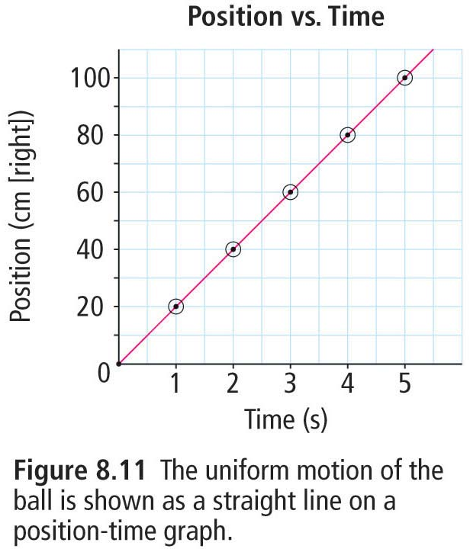
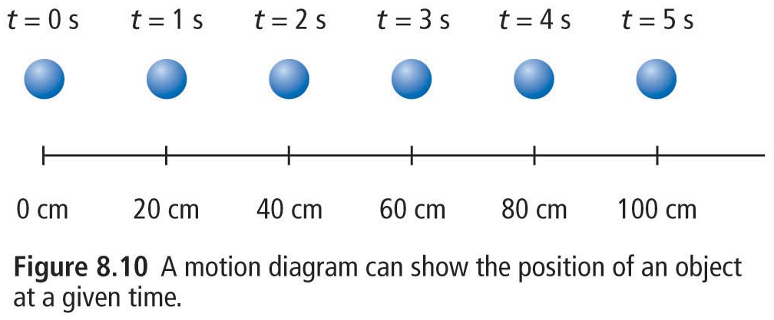
Uniform Motion, Motion Diagrams, and Position-Time Graphs
Objects in uniform motion travel equal displacement in equal time intervals.
A position-time graph shows an object’s position during corresponding time intervals
allows analysis of motion
A motion diagram visually shows an object position at a given time.
helps with visualizing motion

Slide 9
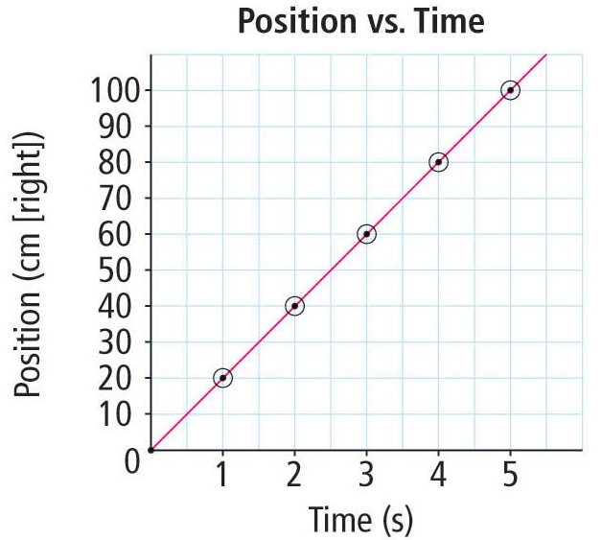
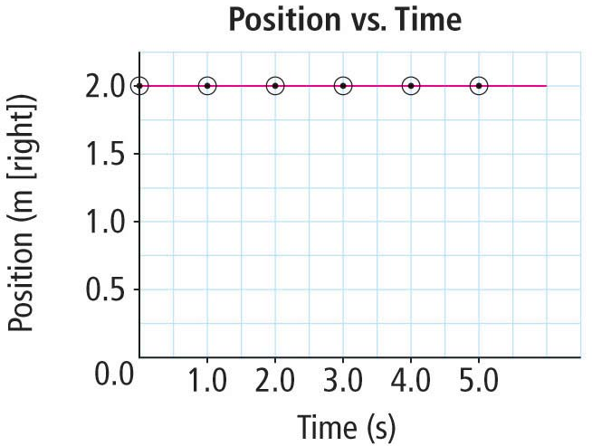
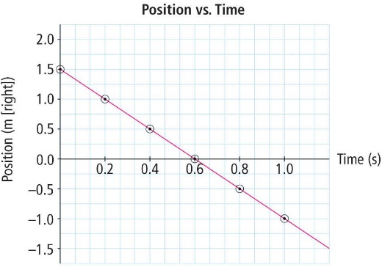
Slope of Position-Time Graphs
A positive slope indicates that position from the origin is increasing or that the object is travelling to the Right, Up, North, or East, RUNE.
A zero slope indicates that the object is stationary.
This is also type of uniform motion.
A negative slope indicates that position from the origin is decreasing or that the object is travelling south, west, down, or to the left.

Slide 10
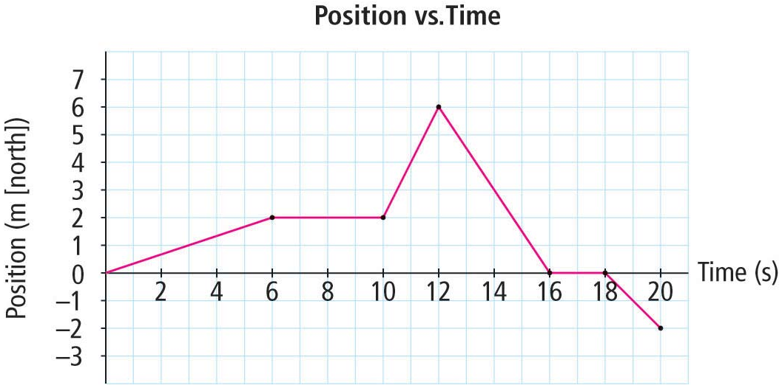
A More Complicated Position-Time Graph
0 s to 6 s
north 2 m
6 s to 10 s
stationary
10 s to 12 s
north 4 m
12 s to 16 s
south 6 m
16 s to 18 s
stationary
18 s to 20 s
south 2 m

Slide 11
Provincial Exam Question
Question
In which of the following situations is the displacement the greatest?
A.
B.
2 m
C.
2 m
D.
2 m
2 m
2 m
2 m
2 m
2 m
2 m
2 m
Answer
B.
For A, displacement is exactly 2 m.
For B, displacement is clearly > 2 m.
For C, the displacement is exactly 2 m.
For D, the displacement is 0 m.

Slide 12
Provincial Exam Question
Question
Which of the following units is associated with the Δd symbol in motion formulae?
A. s
B. m
C. m/s
D. m/s²
Answer
B.
The unit s is for time.
The unit m is for change in distance.
The unit m/s is for speed or velocity.
The units m/s² is for acceleration.

Slide 13
Summary
A scalar quantity has a magnitude, but no direction.
A vector quantity has a magnitude and a direction.
Scalar quantities
Position-Time Graph
Time, $t$
Time interval, $Δt$
Distance, $d$
Vector quantities
Position, $\overset{⃑}{d}$
Displacement, $Δ\overset{⃑}{d}$
$$Δ\overset{⃑}{d}= {\overset{⃑}{d}}_{f}− {\overset{⃑}{d}}_{i}$$
Displacement away from origin
Stationary
Displacement toward origin

Slide 14
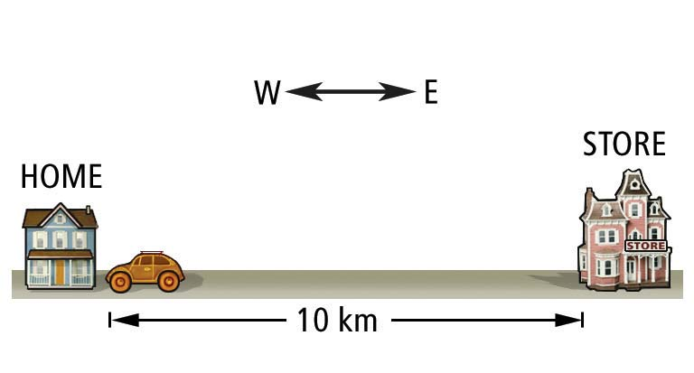
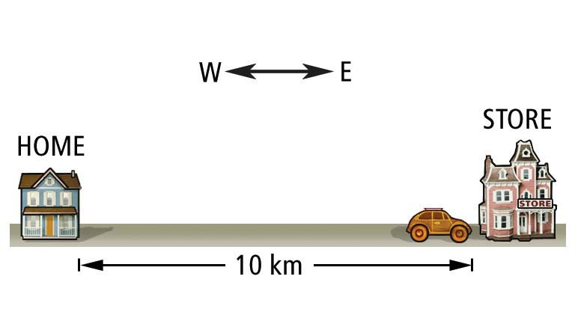
Distance, Position, and Displacement
No direction
Scalar
Distance, $d$
I drove my vehicle 10 km.
I drove my vehicle 10 km [E].
Direction
vector
Position, $\overset{⃑}{d}$
Δ $\overset{⃑}{d}=0 m$
This arrow indicates a vector.
I drove my vehicle 10 km east and then 10 km west.
Direction
vector
displacement,Δ $\overset{⃑}{d}$

Slide 15
Provincial Exam Question
Question
Which of the following subatomic particles completes the nuclear reaction below?
${}_{92}^{235}{U+ {}_{0}^{1}{n → {}_{38}^{94}{Sr+ {}_{54}^{140}{Xe}}}}$ +
one proton
two protons
one neutron
two neutrons
Answer
The total mass on the left is 235 + 1 = 236, therefore the mass on the right must also be 236. The mass of whatever is missing must be 236 – 94 – 140 = 2.
The total charge on the left is 92, therefore the total charge on the right must also be 92. The mass of whatever is missing must be 92 – 38 – 54 = 0.
The option that has a mass of 2 and a charge of 0 is D.

