Slide 1
Average Velocity
PowerPoint 8.2

Slide 2
Speed versus Velocity
scalar quantity
Magnitude but no direction
Speed, $v$, is the distance travelled during a given time interval divided by that time interval, $v= \frac{d}{Δt}=\frac{d_{f} − d_{i}}{t_{f} − t_{i}}$.
vector quantity
Magnitude and direction
Velocity, $\overset{⃑}{v}$, is the displacement during a given time interval divided by that time interval, $\overset{⃑}{v}=\frac{Δ\overset{⃑}{d}}{Δt}=\frac{{\overset{⃑}{d}}_{f} − {\overset{⃑}{d}}_{i}}{t_{f} − t_{i}}$.
The SI units for both $v$and $\overset{⃑}{v}$ is m/s, but km/h is also utilized.

Slide 3
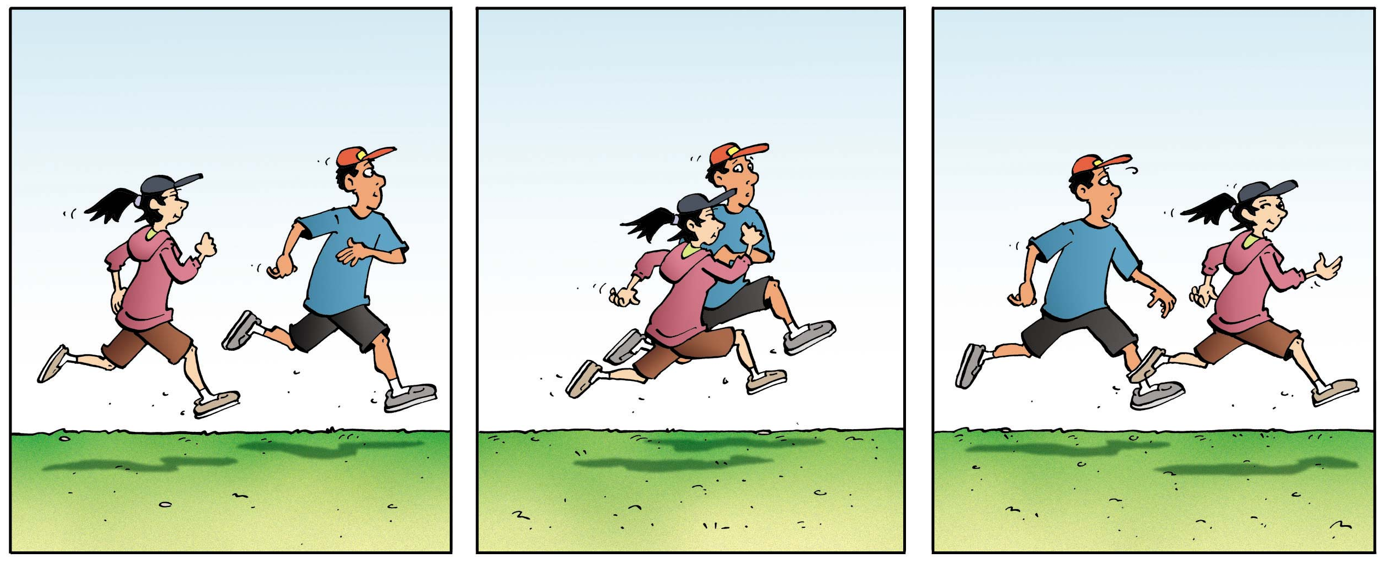
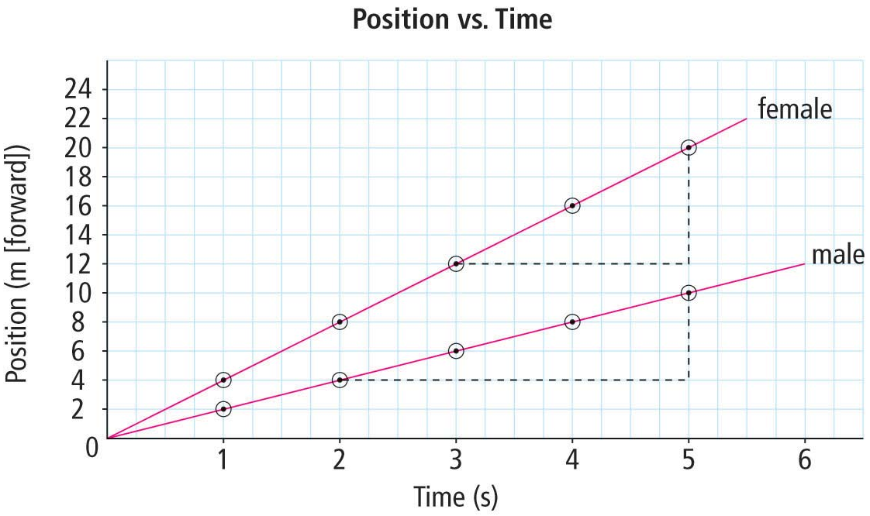
How would you describe the speed and velocity o each jogger?
The female’s $\overset{⃑}{d}$ changes more than the male’s in the same $Δt$.
The female has greater $v$ and greater velocity $\overset{⃑}{v}$ than the male as is shown by the steeper positive slope.

Slide 4
Slope of a Position-Time Graph
Female
Male
$$Slope= \frac{rise}{run}$$
$$Slope= \frac{rise}{run}$$
$position, \overset{⃑}{d} ($m, forward)
$$= \frac{Δ\overset{⃑}{d}}{Δt}$$
$$= \frac{Δ\overset{⃑}{d}}{Δt}$$
$$= \overset{⃑}{v}$$
$$= \overset{⃑}{v}$$
$$= \frac{{\overset{⃑}{d}}_{f} − {\overset{⃑}{d}}_{i}}{t_{f} − t_{i}}$$
$$= \frac{{\overset{⃑}{d}}_{f} − {\overset{⃑}{d}}_{i}}{t_{f} − t_{i}}$$
Time, t (seconds)
The slope of a an object’s position-time graph is its average velocity, ${\overset{⃑}{v}}_{av}$
$$= \frac{20 m −12 m}{5 s −3 s}$$
$$= \frac{10 m −4 m}{5 s −2 s}$$
$$= \frac{8 m}{2 s}$$
$$= \frac{6 m}{3 s}$$
The steeper the slope, the greater the velocity, ${\overset{⃑}{v}}_{av}$
$$=4 \frac{m}{s} forward$$
$$=2 \frac{m}{s} forward$$

Slide 5
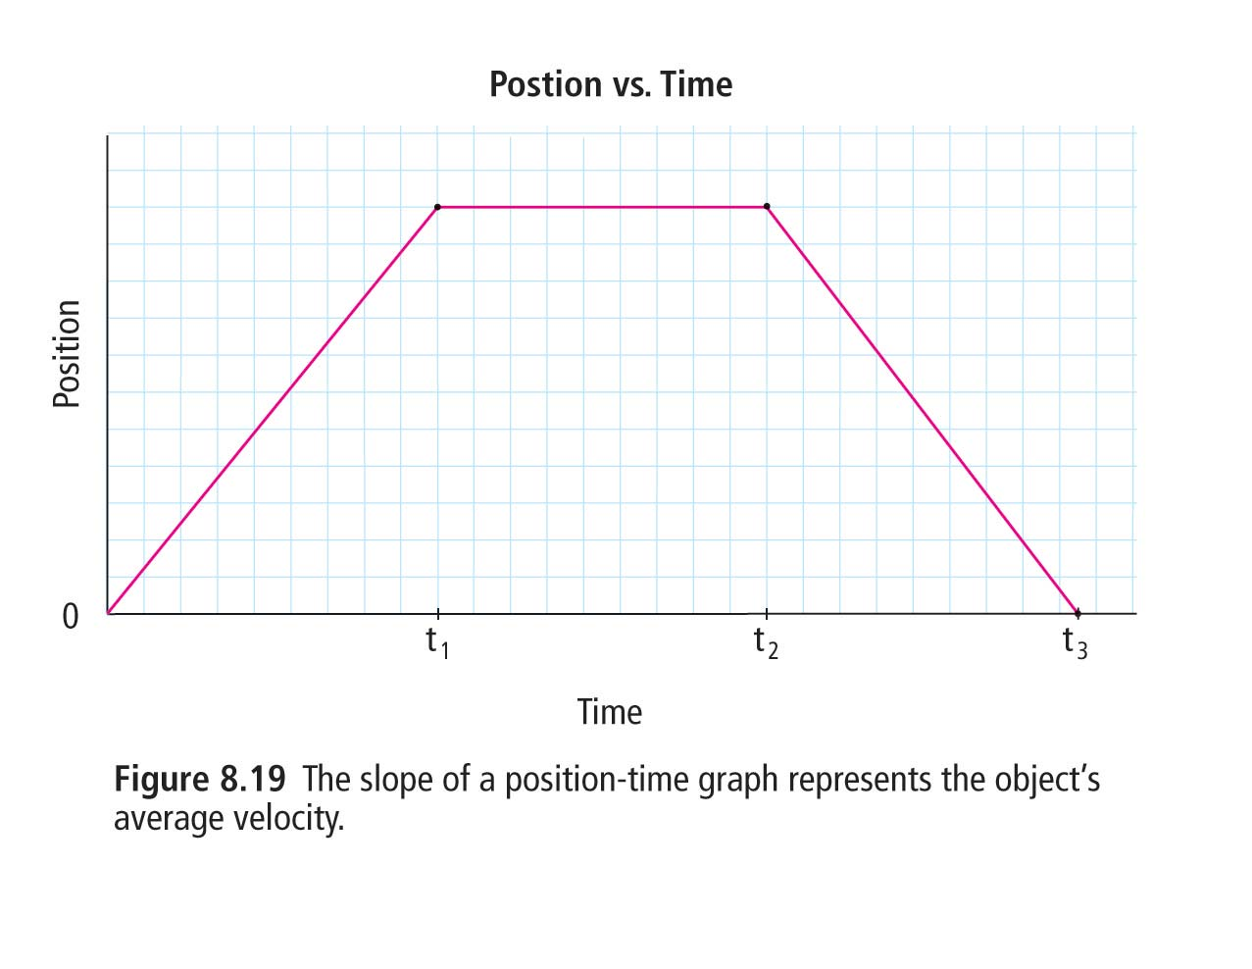
More About Slopes
Positive slope, ${\overset{⃑}{v}}_{av}$ in the positive direction, ${\overset{⃑}{v}}_{av}$ > 0.
Zero slope, stationary, ${\overset{⃑}{v}}_{av}$ = 0.
Negative slope, ${\overset{⃑}{v}}_{av}$ in the negative direction, ${\overset{⃑}{v}}_{av}$ < 0.

Slide 6
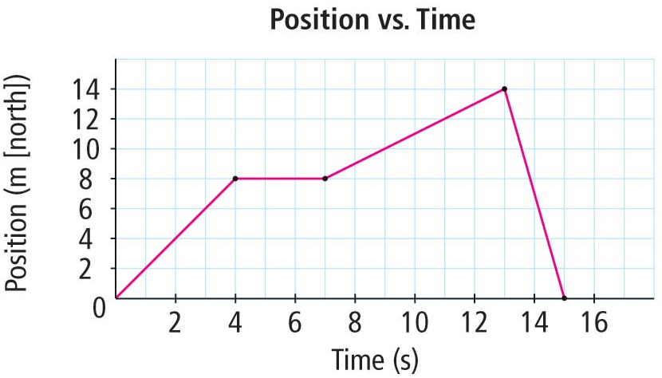
What is the average velocity for the following time intervals?
$${\overset{⃑}{v}}_{av}= \frac{8 m −0 m}{4 s −0 s}$$
$$=2 \frac{m}{s}$$
0 s to 4 s
$${\overset{⃑}{v}}_{av}= \frac{8 m −8 m}{7 s −4 s}$$
$$=0 \frac{m}{s}$$
4 s to 7 s
$${\overset{⃑}{v}}_{av}= \frac{14 m −8 m}{13 s −7 s}$$
$$=\frac{6}{7} \frac{m}{s}$$
7 s to 13 s
$${\overset{⃑}{v}}_{av}= \frac{0 m −14 m}{13 s −15 s}$$
$$=−7 \frac{m}{s}$$
13 s to 15 s

Slide 7
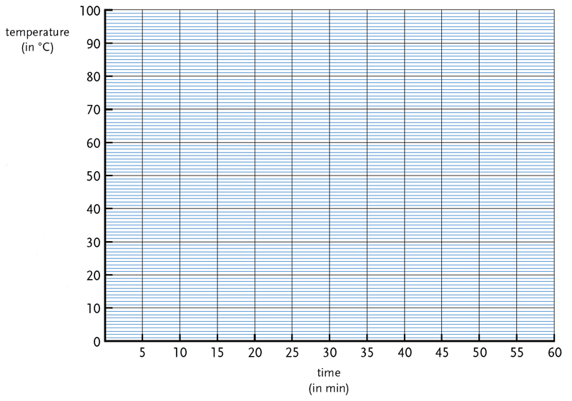
Determining ${\overset{⃑}{v}}_{av}$ with a Line of Best-Fit
In reality, very few things move in uniform motion.
With a line that passes through or close to each point, the average velocity can be calculated.
Position, m
$$Slope= \frac{rise}{run}$$
$$= \frac{40 m −10 m}{40 s −10 s}$$
$$=1 m/s$$
Time, s

Slide 8
Practice with Graphing and Best-Fit Lines
With the data below, construct a position-time graph and plot the data points.
Draw a best-fit line.
Calculate the slope of the best-fit line.
Position (m [E]) | 0 | 7 | 15 | 20 | 26 | 35 | 42 | 49 | 56
Time (s) | 0.0 | 2.0 | 4.0 | 6.0 | 8.0 | 10.0 | 12.0 | 14.0 | 16.0
70
60
50
$$Slope= \frac{rise}{run}= \frac{y_{2} − y_{1}}{x_{2} − x_{1}}$$
40
Position, m
30
$$= \frac{46 m −15 m}{13 s −4 s}$$
20
10
$$=3.4 m/s$$
2
4
6
8
10
12
14
16
Time, s

Slide 9
Calculating Time Intervals and Displacement
$$Δt= \frac{Δ\overset{⃑}{d}}{{\overset{⃑}{v}}_{av}}$$
$${\overset{⃑}{v}}_{av}= \frac{Δ\overset{⃑}{d}}{Δt}$$
$${\overset{⃑}{v}}_{av}·Δt= Δ\overset{⃑}{d}$$
$$Δt·1= \frac{Δ\overset{⃑}{d}}{Δt·{\overset{⃑}{v}}_{av}}·Δt$$
$$\frac{{\overset{⃑}{v}}_{av}}{{\overset{⃑}{v}}_{av}}= \frac{Δ\overset{⃑}{d}}{Δt·{\overset{⃑}{v}}_{av}}$$
$${\overset{⃑}{v}}_{av} · Δt= \frac{Δ\overset{⃑}{d}}{Δt} · Δt$$
Ex. Travelling at 2.5 m/s, how long would it take someone to walk 150 m?
Ex. If a baseball is thrown at 25 m/a toward home plate, what would be the ball’s displacement after 0.65 s?
$$Δt= \frac{Δ\overset{⃑}{d}}{{\overset{⃑}{v}}_{av}}= \frac{150 m}{2.5 m/s}=60 s$$
$Δ\overset{⃑}{d}$ =${\overset{⃑}{v}}_{av}·Δt$ = (25 m/s)(0.65 s) = 16.25 m

Slide 10
Converting Units
Ensure all units are the same before doing calculations or comparisons!
But how?
$$8= \frac{8·4}{4}$$
90 km/h = ? m/s
Units can be treated like factors above and below the division.
$$\left(90 km\right)\left(\frac{1000 m}{1 km}\right)=90 000 m$$
$$\frac{90 000 m}{3600 s}=25 m/s$$
$$\left(1 hour\right)\left(\frac{60 minutes}{1 hour}\right)\left(\frac{60 seconds }{1 minute}\right)=3600 s$$
$$\left(\frac{90 km}{1 hour}\right)$$
$$\left(\frac{1000 m}{1 km}\right)$$
$$\left(\frac{1 hour}{60 minutes}\right)$$
$$\left(\frac{1 minute}{60 seconds}\right)$$
$$= \frac{25 m}{1 s}=25 m/s$$

Slide 11
Provincial Exam Question
Question
If a car moves from +7 m to -21 m in 2 s, what is the car’s average velocity?
A. -14 m/s
B. -7 m/s
C. +7 m/s
D. +14 m/s
Answer
A.
$${\overset{⃑}{v}}_{av}= \frac{Δ\overset{⃑}{d}}{Δt}= \frac{{\overset{⃑}{d}}_{f} − {\overset{⃑}{d}}_{i}}{Δt}= \frac{\left(−21 m\right)−(7 m)}{(2 s)}= \frac{−28 m}{2 s}=−14 m/s$$

Slide 12
Provincial Exam Question
Question
A family on vacation drove 200 km in two hours and then travelled only 40 km during the next hour due to a construction zone. What was the family’s average velocity during the trip?
A. 40 km/h B. 70 km/h C. 80 km/h D. 120 km/h
Answer
C.
$${\overset{⃑}{v}}_{{av}_{1}}= \frac{Δ\overset{⃑}{d}}{Δt}= \frac{200 km}{2 h}=100\frac{km}{h}$$
$${\overset{⃑}{v}}_{{av}_{2}}= \frac{Δ\overset{⃑}{d}}{Δt}= \frac{40 km}{1 h}=40 km/h$$
$${\overset{⃑}{v}}_{av}= \frac{100\frac{km}{h}+100\frac{km}{h}+40\frac{km}{h}}{3}=80 km/h$$

Slide 13
Provincial Exam Question
Question
How far did the girl move during 3s?
A. 3.0 m B. 4.5 m C. 6.0 m D. 9.0 m
10
9
Answer
B.
Plot the data points.
Draw a best-fit line.
At what position is the girl at t = 3 s?
4.5m
8
Time, s | Position, m
0 | 0
2 | 3.0
4 | 6.0
6 | 9.0
7
6
5
Position, m
4
3
2
1
1
2
3
4
5
6
7
Time, s

Slide 14
Provincial Exam Question
Question
Which of the following conditions is represented by the graph?
A. uniform motion
B. zero acceleration
C. constant velocity
D. increasing velocity
Answer
D.
Because the slope of a position-time graph is the velocity, an increasingly steep slope indicates that the velocity is increasing.

Slide 15
Summary
Speed, $v$, is a scalar.
Velocity, $\overset{⃑}{v}$, is a vector.
$${\overset{⃑}{v}}_{av}= \frac{Δ\overset{⃑}{d}}{Δt}$$
Average velocity, ${\overset{⃑}{v}}_{av}$, displacement, $Δ\overset{⃑}{d}$, and time interval, $Δt$, can be calculated from the following formulae
$$Δ\overset{⃑}{d}={\overset{⃑}{v}}_{av}·Δt$$
The slope of a position-time graph represent an object’s ${\overset{⃑}{v}}_{av}.$
$$Δt= \frac{Δ\overset{⃑}{d}}{{\overset{⃑}{v}}_{av}}$$
Unit conversion,
$$\left(\frac{90 km}{1 hour}\right)$$
$$\left(\frac{1000 m}{1 km}\right)$$
$$\left(\frac{1 hour}{60 minutes}\right)$$
$$\left(\frac{1 minute}{60 seconds}\right)$$
$$= \frac{25 m}{1 s}=25 m/s$$

