Slide 1
Describing Acceleration
PowerPoint 9.1

Slide 2
Changes in Velocity
A change in velocity, $Δ\overset{⃑}{v}$, occurs when,
1. an object’s speed changes or
2. its direction of motion changes.
$Δ\overset{⃑}{v}$ can be calculated by subtracting the final velocity, ${\overset{⃑}{v}}_{f}$, by the initial velocity, ${\overset{⃑}{v}}_{i}$,
$$Δ\overset{⃑}{v}= {\overset{⃑}{v}}_{f} − {\overset{⃑}{v}}_{i}$$

Slide 3
Changes in Velocity
$$Δ\overset{⃑}{v}= {\overset{⃑}{v}}_{f} − {\overset{⃑}{v}}_{i}$$
$$Δ\overset{⃑}{v}=\left(65\frac{km}{h}\right)−\left(50\frac{km}{h}\right)=15\frac{km}{h}$$
${\overset{⃑}{v}}_{i}=$50 km/h to the right
${\overset{⃑}{v}}_{f}=$65 km/h to the right

Slide 4
Changes in Velocity
$$Δ\overset{⃑}{v}= {\overset{⃑}{v}}_{f} − {\overset{⃑}{v}}_{i}$$
$$Δ\overset{⃑}{v}=\left(50\frac{km}{h}\right)−\left(70\frac{km}{h}\right)=−20\frac{km}{h}$$
${\overset{⃑}{v}}_{i}=$70 km/h to the right
${\overset{⃑}{v}}_{f}=$50 km/h to the right

Slide 5
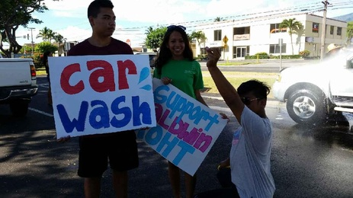
Changes in Velocity
$$Δ\overset{⃑}{v}= {\overset{⃑}{v}}_{f} − {\overset{⃑}{v}}_{i}$$
$$Δ\overset{⃑}{v}=\left(70\frac{km}{h}\right)−\left(70\frac{km}{h}\right)=0\frac{km}{h}$$
${\overset{⃑}{v}}_{i}=$70 km/h to the right
${\overset{⃑}{v}}_{f}=$70 km/h to the right

Slide 6
Changes in Velocity
$$Δ\overset{⃑}{v}= {\overset{⃑}{v}}_{f} − {\overset{⃑}{v}}_{i}$$
$$Δ\overset{⃑}{v}=\left(−10\frac{km}{h}\right)−\left(14\frac{km}{h}\right)=−24\frac{km}{h}$$
F*&@!
I forgot to bring money!
${\overset{⃑}{v}}_{i}=$14 km/h to the right
${\overset{⃑}{v}}_{f}=$10 km/h to the left

Slide 7
Acceleration
The rate at which an object changes its velocity is its acceleration, $\overset{⃑}{a}$.
$\overset{⃑}{a}$is a vector, we must be taken into account magnitude and direction.
If $\overset{⃑}{a}$is not 0, then non-uniform motion is taking place.
For straight line forward motion, in which forward is +,
A positive $\overset{⃑}{a}$indicates an increase in speed.
A negative $\overset{⃑}{a}$indicates a decrease in speed, deceleration.

Slide 8
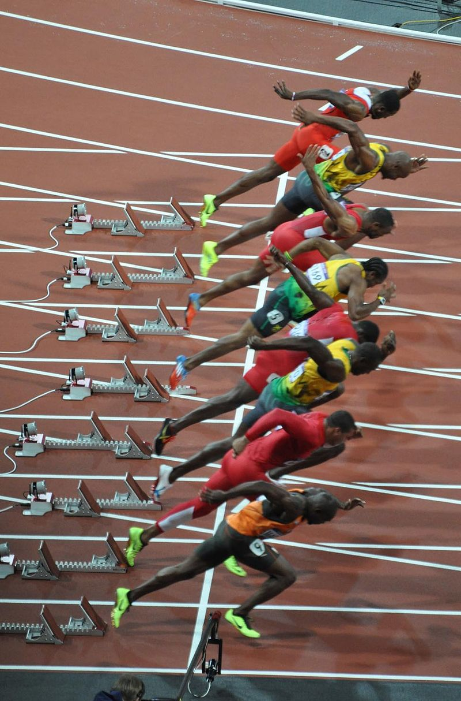
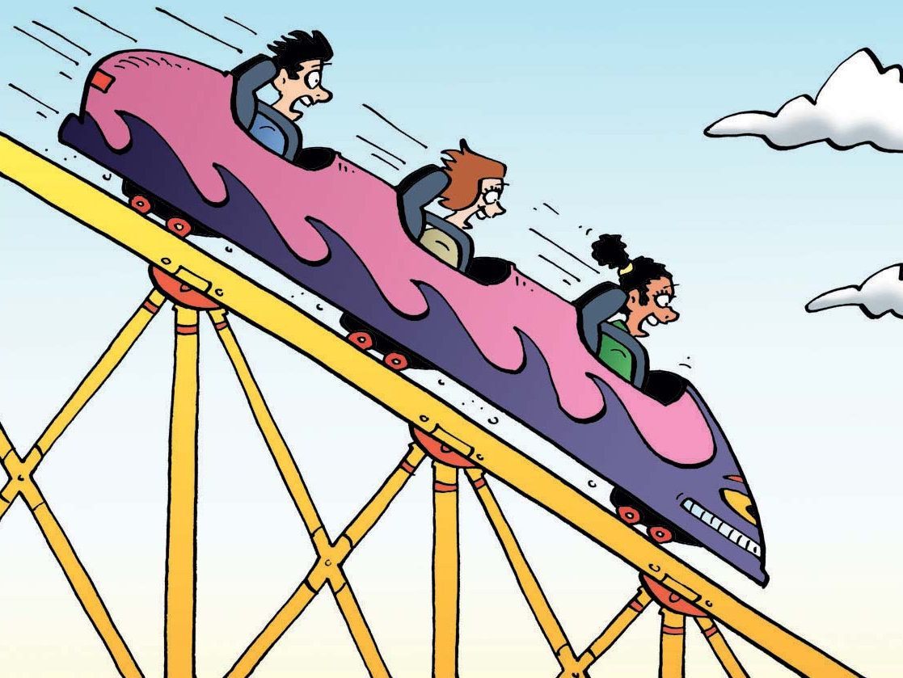
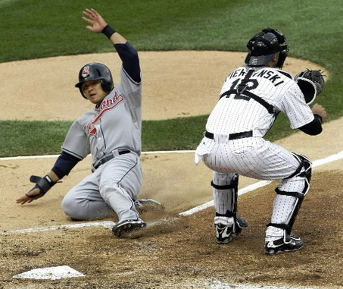
Is Acceleration Positive or Negative?
Positive
Positive
Positive
Negative

Slide 9
Provincial Exam Question
Question
Which of the following situations describes a positive acceleration?
A. a book resting on a desk top
B. a car braking as it approaches a stop sign
C. a speed skater going from rest to 10 m/s in 5 s
D. a skier sliding down a slope with constant velocity
Answer
C.
A. has an acceleration, and a velocity, of zero.
B. has a negative acceleration.
C. has a positive acceleration.
D. has an acceleration of zero also as the skier has uniform motion, its velocity is constant

Slide 10
Provincial Exam Question for 9.2
Question
Which of the following graphs shows a car travelling at a constant velocity of +50 km h, then slowing down to +30 km has it enters a school zone?
A. B.
C. D.
Answer
D.

Slide 11
Summary
A change in velocity, $Δ\overset{⃑}{v}$, occurs when,
1. an object’s speed changes or
2. its direction of motion changes.
Acceleration, $\overset{⃑}{a}$, is a vector.
For straight line forward motion, in which forward is +,
A positive $\overset{⃑}{a}$indicates an increase in speed.
A negative $\overset{⃑}{a}$indicates a decrease in speed, deceleration.

