Slide 1
Calculating Acceleration
PowerPoint 9.2

Slide 2
Velocity-Time Graphs
A velocity-time graph illustrates an object’s $Δ\overset{⃑}{v}$, which is the object’s $\overset{⃑}{a}.$
Time (s) | 0.0 | 1.0 | 2.0 | 3.0 | 4.0
Velocity (m/s) | 0.0 | 12.5 | 25.0 | 37.5 | 50.0
$$Slope=\frac{Δ\overset{⃑}{v}}{Δt}$$
$$= \overset{⃑}{a}$$
70
60
$$= \frac{{\overset{⃑}{v}}_{f} − {\overset{⃑}{v}}_{i}}{t_{f} − t_{i}}$$
50
40
Velocity, m/s
30
$$=\frac{50\frac{m}{s}−12.5\frac{m}{s}}{4 s −1 s}$$
$$=12.5 \frac{m}{s^{2}}$$
20
10
1
2
3
4
Units for acceleration
Time, s

Slide 3
Velocity-Time Graphs
If $\overset{⃑}{a}$ is constant, then $Δ\overset{⃑}{v}$ will be the same over identical $Δt$.
In reality, constant acceleration is rare and a best-fit line is drawn in order to determine an object’s average acceleration, ${\overset{⃑}{a}}_{av}$.
A straight line on a velocity-time graph is constant acceleration.
$${\overset{⃑}{a}}_{av}= \frac{Δ\overset{⃑}{v}}{Δt}$$
70
60
$$= \frac{{\overset{⃑}{v}}_{f} − {\overset{⃑}{v}}_{i}}{t_{f} − t_{i}}$$
50
40
Velocity, m/s
30
$$=\frac{50\frac{m}{s}−12.5\frac{m}{s}}{4 s −1 s}$$
$$=12.5 \frac{m}{s^{2}}$$
20
10
1
2
3
4
Time, s

Slide 4
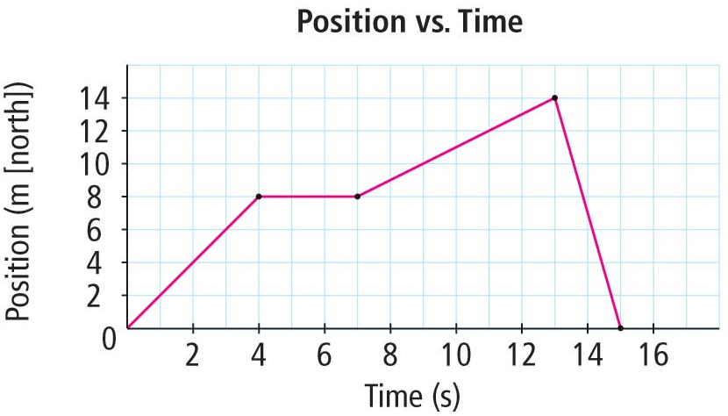
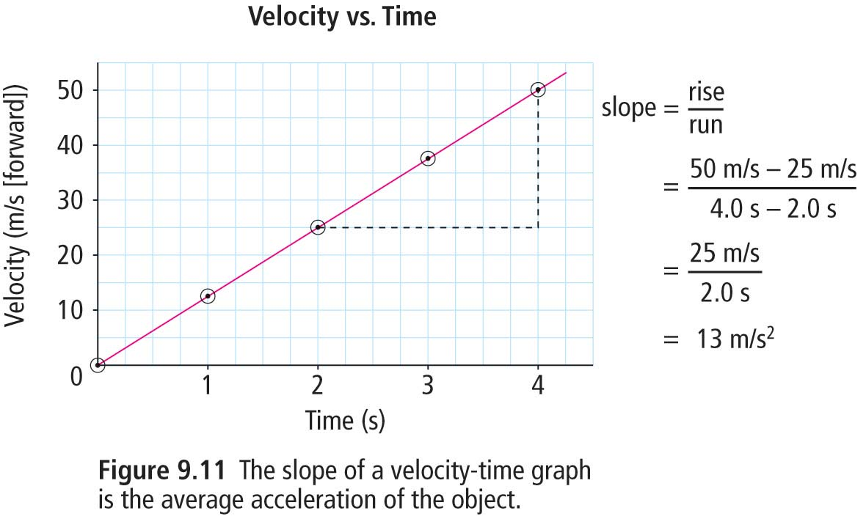
Comparison Between Graphs
Position-Time Graphs, from 8.2
Velocity-Time Graphs
Useful for objects at constant velocities
$Slope= {\overset{⃑}{v}}_{av}$
Useful for objects whose velocity is not-constant
Shows changes in velocity and acceleration of an object
$Slope= \overset{⃑}{a}$ or ${\overset{⃑}{a}}_{av}$

Slide 5
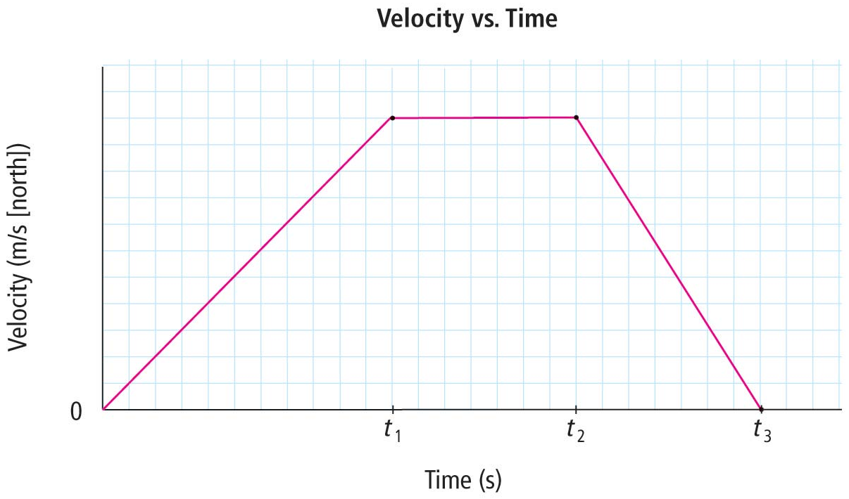
Determining Motion from a Velocity-Time Graph
$$0 to t_{1}$$
Constant positive $\overset{⃑}{a}$,
in a northerly direction
$$t_{1} to t_{2}$$
$\overset{⃑}{a}=0$,
travelling at a constant $\overset{⃑}{v}$
$$t_{2} to t_{3}$$
Constant negative $\overset{⃑}{a}$,
in a southerly direction
$$0$$
$$t_{1}$$
$$t_{2}$$
$$t_{3}$$

Slide 6
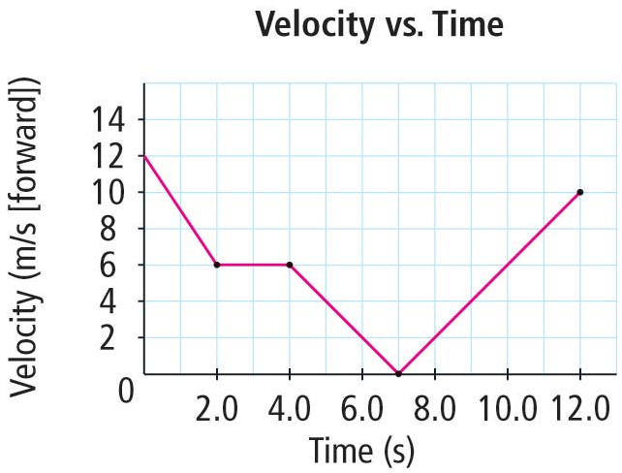
Practice Calculating $\overset{⃑}{a}$ from a Velocity-Time Graph
0 s to 2 s
$$= \frac{\left(6\frac{m}{s}\right)−\left(12\frac{m}{s}\right)}{\left(2 s\right)−(0 s)}$$
$$\overset{⃑}{a}= \frac{v_{f} − v_{i}}{t_{f} − t_{i}}$$
$$=−3 \frac{m}{s^{2}}$$
2 s to 4 s
$$\overset{⃑}{a}= \frac{v_{f} − v_{i}}{t_{f} − t_{i}}= \frac{\left(6\frac{m}{s}\right)−\left(6\frac{m}{s}\right)}{\left(4 s\right)−(2 s)}=0 \frac{m}{s^{2}}$$
4 s to 7 s
$$\overset{⃑}{a}= \frac{v_{f} − v_{i}}{t_{f} − t_{i}}= \frac{\left(0\frac{m}{s}\right)−\left(6\frac{m}{s}\right)}{\left(7 s\right)−(4 s)}=−2 \frac{m}{s^{2}}$$
7 s to 12 s
$$\overset{⃑}{a}= \frac{v_{f} − v_{i}}{t_{f} − t_{i}}= \frac{\left(10\frac{m}{s}\right)−\left(0\frac{m}{s}\right)}{\left(12 s\right)−(7 s)}=2 \frac{m}{s^{2}}$$
Page 396 in the textbook

Slide 7
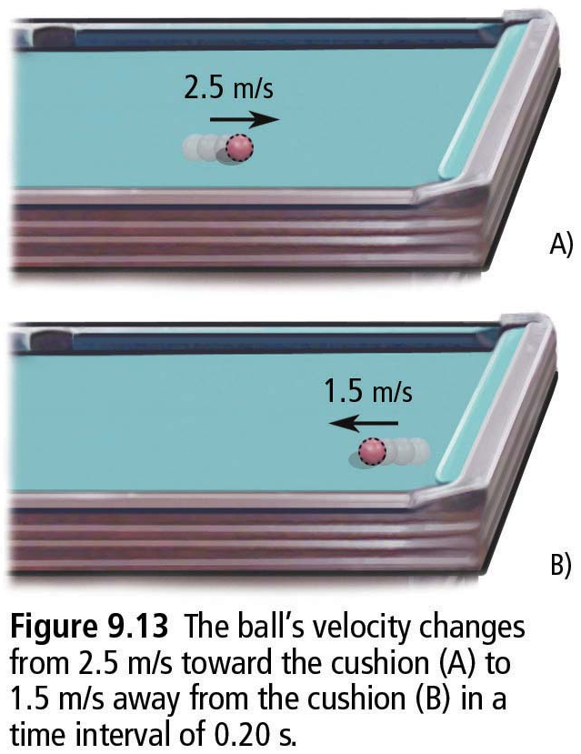
Try Calculating $\overset{⃑}{a}$ without a Graph
Question
The ball’s velocity changes from 2.5 m/s toward the cushion to 1.5 m/s away from the cushion in a time interval of 0.20 s.
Answer
$$\overset{⃑}{a}= \frac{Δ\overset{⃑}{v}}{Δt}$$
$$= \frac{{\overset{⃑}{v}}_{f} − {\overset{⃑}{v}}_{i}}{t_{f} − t_{i}}$$
$$=\frac{\left(−1.5\frac{m}{s}\right)−\left(2.5\frac{m}{s}\right)}{0.20 s}$$
$$=−20 \frac{m}{s^{2}}$$

Slide 8
Calculating $Δ\overset{⃑}{v}$ and $Δt$
The formula for $\overset{⃑}{a}$ can also be rewritten to calculate $Δ\overset{⃑}{v}$ or $Δt$.
$$\overset{⃑}{a}= \frac{Δ\overset{⃑}{v}}{Δt}$$
$$Δt= \frac{Δ\overset{⃑}{v}}{\overset{⃑}{a}}$$
$$Δ\overset{⃑}{v}= \overset{⃑}{a}Δt$$
Remembering the formula $Δ\overset{⃑}{v}= {\overset{⃑}{v}}_{f} − {\overset{⃑}{v}}_{i}$, one can also calculate initial and final velocity.

Slide 9
Try this Practice Problem
Question
A motorcycle is travelling north at 11 m/s. How much time would it take for the motorcycle to increase its velocity to 26 m/s [N] if it accelerated at 3.0 m/s²?
Be sure to write this part down.
Answer
Write down what you know
Identify what you’re asked to find.
Find formulae which will help you find what you’re looking for and that contain values that are known.
$$= \frac{\left(15\frac{m}{s}\right)}{3.0 \frac{m}{s^{2}}}=5 s$$
1. $\overset{⃑}{a}=3.0 \frac{m}{s^{2}}$
$$v_{i}=11\frac{m}{s}$$
$$v_{f}=26\frac{m}{s}$$
2. $Δt= ?$
3. $Δt= \frac{Δ\overset{⃑}{v}}{\overset{⃑}{a}}$
$$=\left(26\frac{m}{s}\right)−\left(11\frac{m}{s}\right)=15\frac{m}{s}$$
$Δ\overset{⃑}{v}= {\overset{⃑}{v}}_{f} − {\overset{⃑}{v}}_{i}$

Slide 10
Try this Practice Problem
Question
A skier moving 6.0 m/s forward begins to slow down, accelerating at
-2.0 m/s² for 1.5 s. What is the skier’s velocity at the end of the 1.5 s?
Answer
Write down what you know.
Identify what you’re aske to find.
Find formulae which will help you find what you’re looking for and that contain values that are known.
1. $\overset{⃑}{a}=−2.0 \frac{m}{s^{2}}$
$Δt=1.5 s$
${\overset{⃑}{v}}_{i}=6.0\frac{m}{s}$
2. ${\overset{⃑}{v}}_{f}= ?$
3. $Δ\overset{⃑}{v}= {\overset{⃑}{v}}_{f} − {\overset{⃑}{v}}_{i}$
$\left(−3.0\frac{m}{s}\right)= {\overset{⃑}{v}}_{f} −\left(6.0\frac{m}{s}\right)$
$${\overset{⃑}{v}}_{f}=3.0\frac{m}{s}$$
$$=\left(−2.0\frac{m}{s^{2}}\right)\left(1.5s\right)=−3.0\frac{m}{s}$$
$$Δ\overset{⃑}{v}= \overset{⃑}{a}Δt$$

Slide 11
Provincial Exam Question
Question
Which of the following graphs shows a car travelling at a constant velocity of +50 km h, then slowing down to +30 km has it enters a school zone?
A. B.
C. D.
Answer
D.

Slide 12
Provincial Exam Question
Question
On the surface of the moon, the acceleration due to gravity is −1.6 m/s². If a ball is thrown upward at +20 m/s, how long does it take for the ball to reach a velocity of
0 m/s before falling back to the surface of the moon?
A. 0.08 s
B. 12.5 s
C. 20 s
D. 32 s
$$= \frac{\left(−20\frac{m}{s}\right)}{\left(−1.6 \frac{m}{s^{2}}\right)}=12.5 s$$
Answer
B.
3. $Δt= \frac{Δ\overset{⃑}{v}}{\overset{⃑}{a}}$
1. $\overset{⃑}{a}=−1.6 \frac{m}{s^{2}}$
2. $Δt= ?$
$${\overset{⃑}{v}}_{i}= +20\frac{m}{s}$$
$$Δ\overset{⃑}{v}= {\overset{⃑}{v}}_{f} − {\overset{⃑}{v}}_{f}=\left(0\frac{m}{s}\right)−\left(20\frac{m}{s}\right)=−20\frac{m}{s}$$
$${\overset{⃑}{v}}_{f}= 0\frac{m}{s}$$

Slide 13
Provincial Exam Question
Question
A car moving at +15 m/s pulls onto the highway and accelerates at +1.2 m/s² for 8.2 seconds. What is its final velocity?
A. +9.8 m/s
B. +16.2 m s
C. +20.7 m s
D. +24.8 m s
Answer
D.
1. $\overset{⃑}{a}=+1.2 \frac{m}{s^{2}}$
2. ${\overset{⃑}{v}}_{f}= ?$
3. $Δ\overset{⃑}{v}= {\overset{⃑}{v}}_{f} − {\overset{⃑}{v}}_{f}$
$$\left(9.84\frac{m}{s}\right)= {\overset{⃑}{v}}_{f}−\left(15\frac{m}{s}\right)$$
$${\overset{⃑}{v}}_{i}= +15\frac{m}{s}$$
$${\overset{⃑}{v}}_{f}=24.8\frac{m}{s}$$
$$Δ\overset{⃑}{v}= \overset{⃑}{a}Δt=\left(1.2 \frac{m}{s^{2}}\right)\left(8.2 s\right)=9.84\frac{m}{s}$$
$$Δt=8.2 s$$

Slide 14
Summary
Velocity-time graphs allow for analysis if changes in velocity over time. The slope of the best-fit line in such a graph is an object’s acceleration.
With the formulae below, one can calculate the initial velocity, ${\overset{⃑}{v}}_{i}$, the final velocity, ${\overset{⃑}{v}}_{f}$, the time interval, $Δt$, and the acceleration, $\overset{⃑}{a}$, of an object in motion.
$$\overset{⃑}{a}= \frac{Δ\overset{⃑}{v}}{Δt}$$
$$Δt= \frac{Δ\overset{⃑}{v}}{\overset{⃑}{a}}$$
$$Δ\overset{⃑}{v}= {\overset{⃑}{v}}_{f} − {\overset{⃑}{v}}_{i}$$
$$Δ\overset{⃑}{v}= \overset{⃑}{a}Δt$$

